Slide 1
Tax return for 2020 information for students and researchers employed at UCT Prague
Anna Mittnerová, anna.mittnerova@vscht.cz
VŠCHT Praha, Zahraniční oddělení

Slide 2
Personnel department of UCT Prague building B, room 101
Information for Employees (taxes) in English:
https://intranet.vscht.cz/human-resources/information-for-employees OKbase Attendance System https://okbase.vscht.cz/okbase/welcome.action?dsAll=1
download
Personal data

Slide 3
Income Tax Legislation - Czech Republic
Act No. 586/1992 Coll. On Income Taxes (o daních z příjmu) - complicated http://www.czechlegislation.com/act-no-586-1992-coll-on-income-taxes/
Incomes taxable in the Czech Republic:
§ 6 Employment Income – usual case of working students, researchers and academics
§ 7 Income from independent activities (self- employment)
§ 8 Capital gains
§ 9 Income from rent of a property
§ 10 Other incomes
§6 - Employment Income is taxed on the base of SUPER GROSS SALARY (SGS)
SGS is calculated as gross salary increased by 33,8 % of the employer´s part of the Czech obligatory social security (SS) and health insurance (HI) contributions.
In general, the total income is taxed at a flat rate of 15 %
In case of annual income being > 1 672 080 CZK, an additional solidarity tax is paid.

Slide 4
Types of working contracts - (HPP, DPP, DPČ)
Pracovní smlouva (HPP) Employment Contract
Contract is concluded for the agreed period
Share (úvazek) of working hours is determined, either as a full time = 40 hours per week, or part time share (částečný pracovní úvazek) in % of full time, according agreement
You receive a Salary statement (Mzdový výměr) with a salary tariff class based on type of work
If relevant a Personal bonus from the project (Osobní příplatek z projektu)
Additionally to your gross salary UCT Prague pays obligatory contribution to a social security and health insurance in amount of 33,8 % of gross salary
Dohoda o provedení práce (DPP) Agreement on Work Performance
You are paid on the basis of number of hours worked multiplied by an hourly rate of pay
The wage is usually lower then 10 000 CZK in one month, maximum 300 hours per year
NO contribution for social security and health insurance is paid ⇒
Super gross wage = Gross wage is taxed at 15 %
Dohoda o pracovní činnosti ( DPČ) Agrement on Work Activity
It is rarely used, only for half time contracts, for salary > 3 500 CZK social and health insurance is obligatory

Slide 5
How was your Net Salary calculated in 2020 in the CR
Monthly Net Salary = Gross salary - (SS+HI paid by employee) - Income tax
Example:
monthly Net Salary is 34 465 CZK = 50 000 CZK - 5 500 CZK – 10 035 CZK
However, your net income can be increased by tax reliefs and benefits that you, or your spouse, have to request either at your employer (UCT Prague) or at the Czech tax office (Finanční úřad)
Czech tax residents are entitled to all tax relieves and tax benefits
Czech tax non-residents only to basic tax relief and student tax relief
Contribution for | paid by employee | paid by employer
Social Security (SS) | -6,50% | 24,80%
Health Insurance (HI) | -4,50% | 9,00%
TOTAL SS + HI | -11,00% | 33,80%
Monthly Gross Salary | SS+HI - 11 % | SS+HI 33,8% | Super Gross Salary | Income Tax 15%
50 000 Kč | -5 500 Kč | 16 900 Kč | 66 900 Kč | -10 035 Kč

Slide 6
Annual Tax Reliefs and Allowances for 2020 applicable for any resident of Czech Republic or EU/EEC, if the income from CR is at least 90% of overall taxpayer´s income
Tax relieves | Amount/year | Conditions | Required documents
Taxpayer relief | 24 840 CZK | Applicable for everyone also for non-residents | No confirmation needed
Spouse relief | 24 840 CZK | The spouse´s annual income is lower then 68 000 CZK (excluding social security benefits e.g. parental benefits) | Confirmation of spouse´s employer or signed Affidavit if the spouse is not employed
Student relief | 4 020 CZK | Until the age of 26 or 28 for PhD students (resident and non-resident) | Confirmation of study for the whole year
Disability relief | a) 2 520 CZK b) 5 040 CZK c) 16 140 CZK | The taxpayer is recognized as disabled Amount depends on the degree of disability | Confirmation about the grade of your disability
Relief on child´s placement to the kindergarten | 14 800 CZK | The child is living with the taxpayer in the common household | Confirmation about payments to kindergarten
Allowance on children | 1. - 15 204 CZK 2. - 19 404 CZK 3. – 24 204 CZK | The child is living with the taxpayer in the common household | Birth certificate of the child, confirmation of other parent´s employer that he/she doesn´t apply the same allowance or Affidavit

Slide 7
Personal Deductions from the Tax Basement for 2020 (ZDP § 15)
Tax base deduction | Deductable amount/year | Conditions | Required documents
Donation for charitable purposes, incl. blood donation | Max. 15% of tax basement 3 000 CZK for blood donation | At least 2% of tax basement, minimum amount is 1000 CZK | Confirmation of the gift donated (contract, confirmation of an recipient of a gift), confirmation of a blood donation
Mortgage interests | Max. 300 000 CZK per a household | Contract with the bank, to finance the taxpayer's permanent housing | Confirmation of provided bank credit for housing needs and of the amount of interests from this bank credit
Pension insurance contributions | Max. 24 000 CZK | Payment of insurance for at least 5 years and simultaneously not withdrawn earlier than in 60 years of age | Confirmation of paid amounts for pension insurance, supplementary insurance and additional pension savings
Life insurance contribution | Max. 24 000 CZK | Payment of insurance for at least 5 years and simultaneously not withdrawn earlier than in 60 years of age | Confirmation of paid amounts for private life insurance
Membership fee to the Trade union organisation | 1,5% of taxable income, max 3000 CZK | Membership in the Trade union organization | Confirmation on membership fees paid
Expenses for exams for additional education | Max 10 000 CZK | In accordance with the law on recognition of the Results of further education | Confirmation of paid remuneration for further education

Slide 8
International Income Tax legislation for those who received income in 2020 from two or more countries
Every country wants to collect as much taxes as possible
The rules are set out in a bilateral Treaties (Conventions) on Avoidance of Double Taxation between the Czech Republic and particular country - https://www.mfcr.cz/cs/legislativa/dvoji-zdaneni/prehled-platnych-smluv
The tax residence of a taxpayer is important in determining which country is entitled to income taxation
The rules for determining tax residence are set forth:
In the Czech Act on Income Tax, No. 586/1992, Article (§) 2
In other country´s domestic law on income tax
In the Treaty (Convention) on Avoidance of Double Taxation, in Article 4
Some treaties contains exception for students, researchers, academics, they are then taxed in only one country

Slide 9
Tax Residence of Foreigners - Obligations and Benefits
Conditions for tax residency in the Czech Republic (CR)
to be present in the CR for at least 183 days (in aggregate) in a given calendar year
to live here, to have an address here, a working contract and work here
to have here a center of vital interests - a spouse, children living in a common household
Czech tax resident
Benefits – a tax resident can require all tax reliefs and benefits in the Czech Republic
Obligation – he/she is taxed on a worldwide incomes in the CR according a convention on avoidance of a double taxation between the CR and respective country
Czech tax non-resident
A non-resident is taxed in Czech republic ONLY from incomes from the sources of the CR
He/she has to tax worldwide incomes in the country of his/her tax residence
Benefits – a non-resident can claim ONLY the basic tax relief that is 2 070 CZK per month for 2020 and tax benefit for students (up to age of 28 years)

Slide 10
Request for the Certificate of the Tax-Payer´s Residence Issuance Žádost o vydání / legalizaci potvrzení o daňovém domicilu
https://www.financnisprava.cz/assets/en/attachments/ita-international-tax-affairs/Request_for_issuance_of_the_Certificate_of_Tax-payers_residence_specimen.pdf
Fill in and sign a form „ Žádost o vydání potvrzení o daňovém domicilu“Request for the certificate of the tax-payer´s residence issuance
Attachments:
Copy of your Passport, your card of Long term residence permit at the territory of the Czech Republic
Copy of your accommodation agreement or rent agreement in the Czech Republic
Copy of your working contract with the UCT Prague
Revenue stamp – KOLEK – in amount of 100 CZK, available at the post office
Do not hesitate to ask me for the form and to check completed „Request“ (anna.mittnerova@vscht.cz)
Request needs to be submitted at the very beginning of the year to the „PODATELNA“ or sent by registered mail to the Tax office at the city district where you live https://www.statnisprava.cz/rstsp/ciselniky.nsf/i/d0027?opendocument&:CZ010

Slide 11
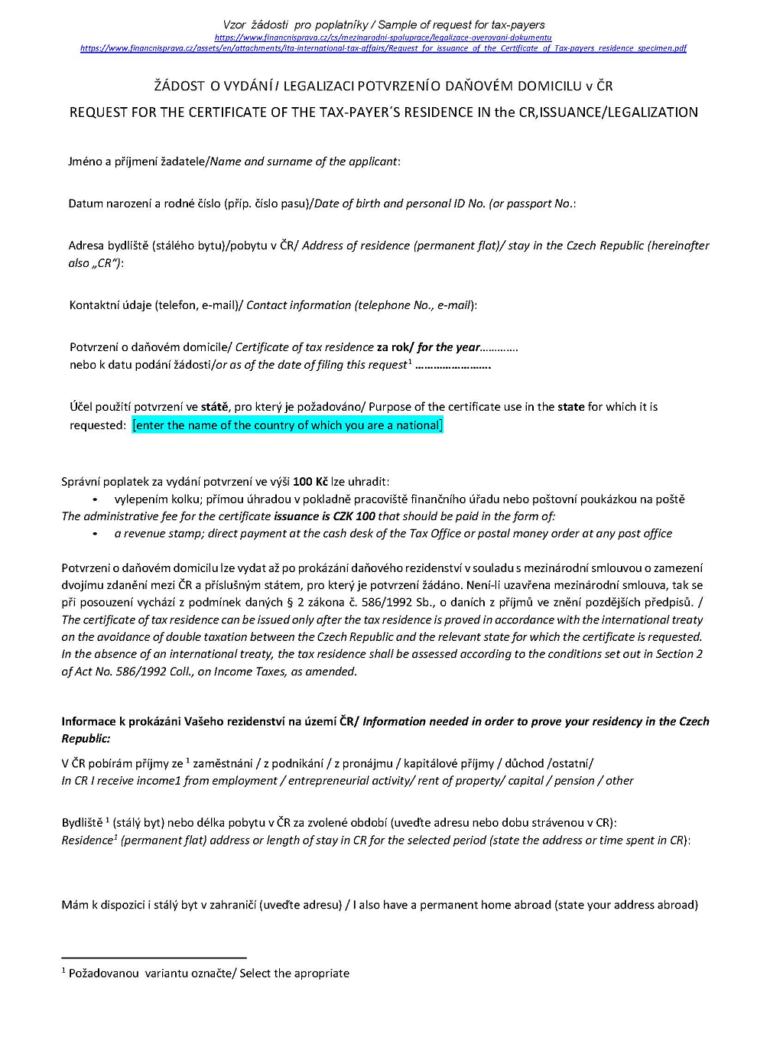
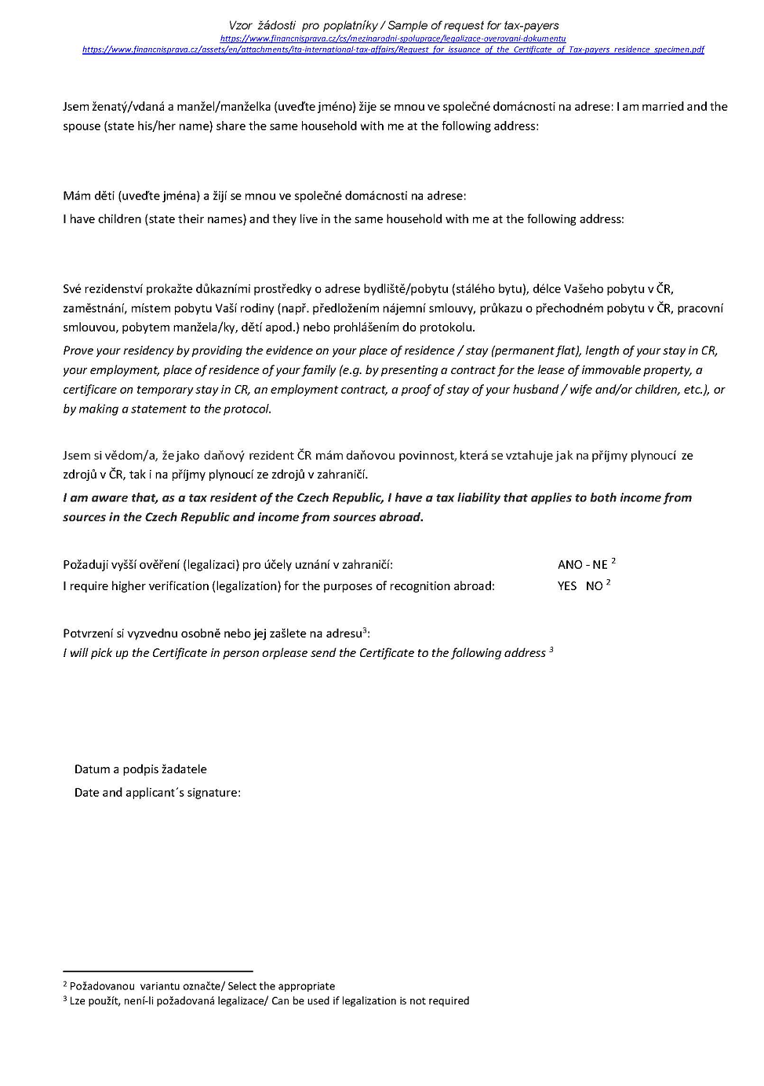

Slide 12
REQUEST for Annual Settlement of Prepayments and Tax Benefits for 2020 with the Employer (UCT Prague) Žádost o roční zúčtování záloh a daňového zvýhodnění
You can require Personnel Department of UCT Prague for annual settlement of your tax prepayments and benefits, on behalf of you
Conditions of the Request for the year 2020:
Total income came only from employment in the Czech Republic
Income came from only UCT Prague or from one or more consecutive employers, the last being UCT Prague
You have to fill in and sign the form „Žádost o roční zúčtování daně“ (Request for annual settlement of prepayments and tax benefits)
This pre-filled form is available in your OKBase profile ( see slide 2)
Until when? no later than by February 15, 2021

Slide 13
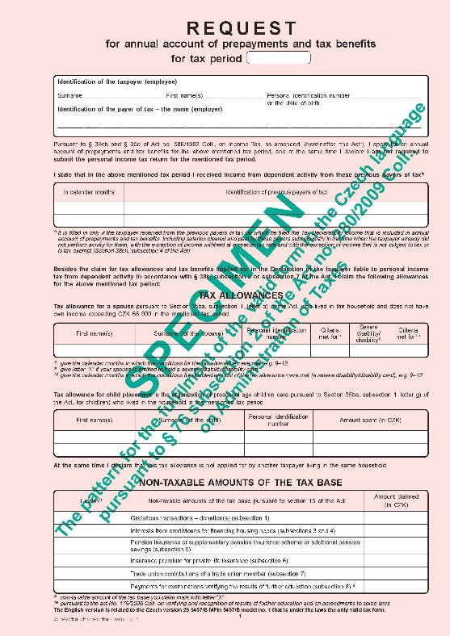
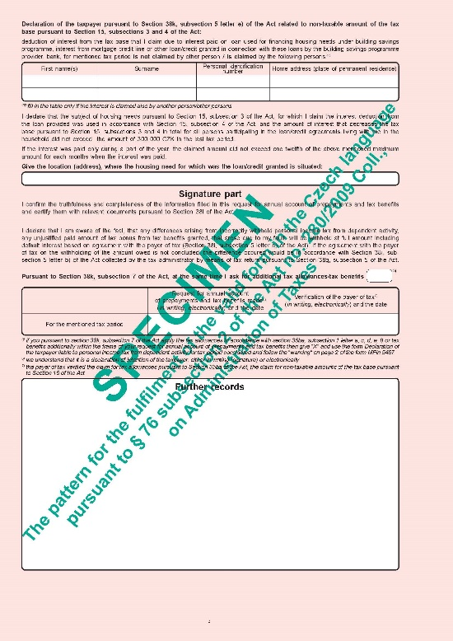
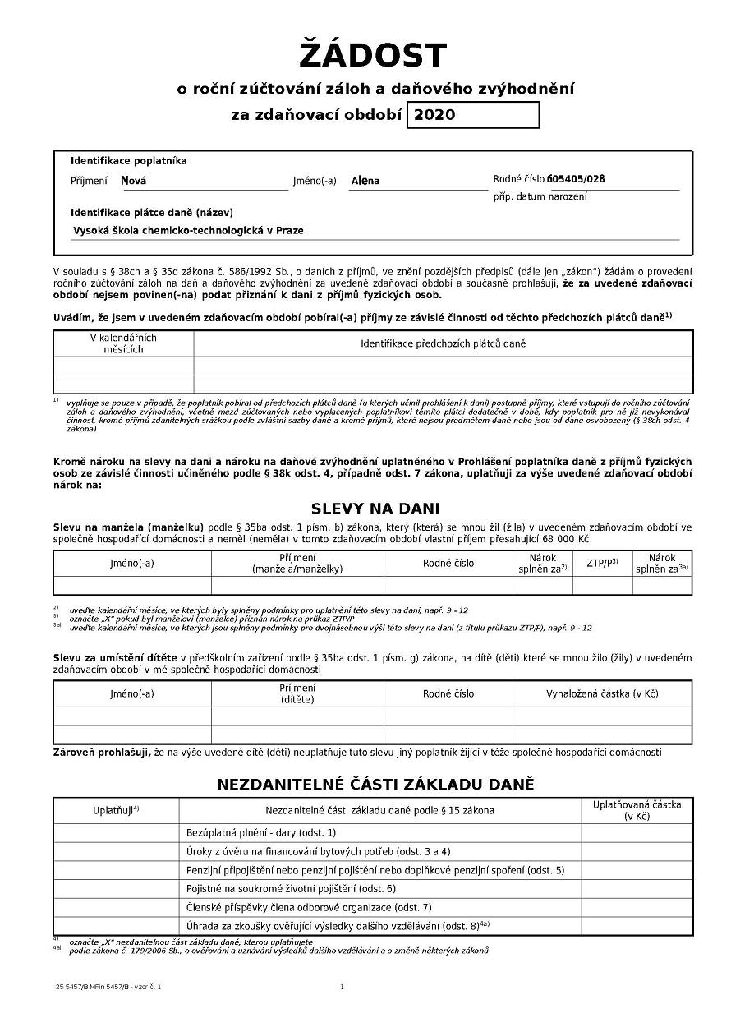
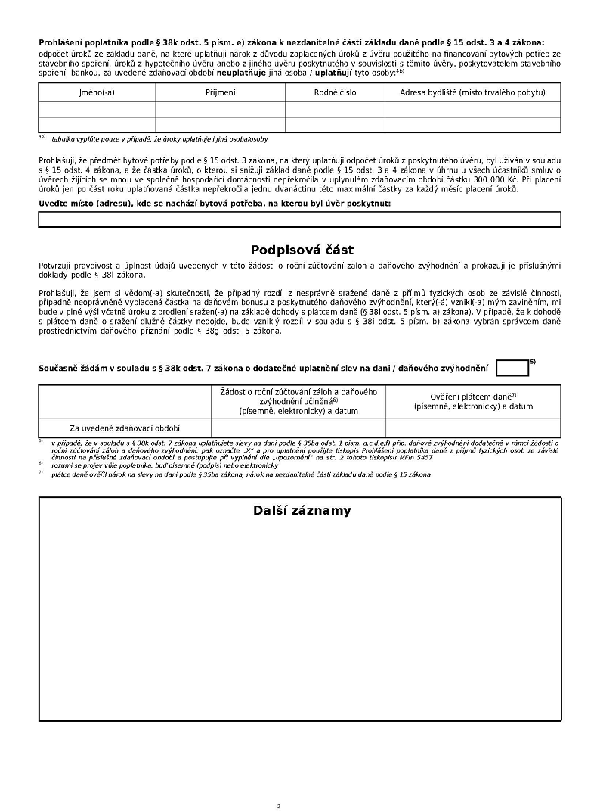
REQUEST for annual settlement of prepayments and tax benefits for year 2020
Deliver till 15/2/2021 to Personnel Dept.
Žádost o roční zúčtování záloh a daňového zvýhodnění za 2020
Dodejte do 15/2/2021 na PO
Date + signature

Slide 14
Proofs for Personnel Department to claim Tax Reliefs, B enefits
Proof of study, PhD up to age of 28 years
Certificate on your Czech Tax Residence
Marriage certificate if you claim benefits for a spouse with annual income < 68 000 CZK
Affidavit that your dependent spouse has annual income lower then 68 000 CZK
Declaration that your spouse does not claim benefit for a child/children
Birth certificates of your child/ children
Confirmation of payment of the fee in a kindergarten/nursery school
Other confirmations according the benefits required
General rule - inform Personnel Department during the year about all changes – birth of a child, change of address, etc..

Slide 15
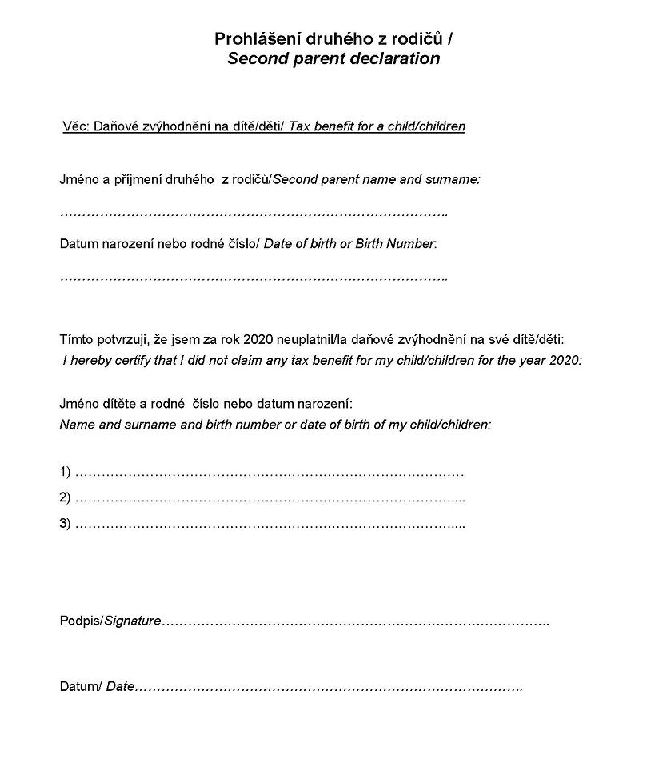
Čestné prohlášení/ Affidavit
Na manžela/ku ve společně hospodařící domácnosti / of a spouse living in a common houshold
Prohlášení druhého z rodičů / Second parent declaration

Slide 16
Filing a Tax Return for 2020 by a Taxpayer
Deadline for filing is March 31, 2021 but start sooner, don´t leave it to the last minute
The tax return needs to be filed at the relevant Tax Office in the city district where you live
Fill in tax forms, attach confirmation and other proofs, state the number of your bank account, sign
Mandatory attachments
Certificate of taxable incomes from dependent activity for 2020 issued by UCT Prague,
Certificate of taxable incomes…. issued by other employer
documents proving your request according to the type of reliefs and benefits you are claiming
Forms are available only in the Czech language, translation to English are published as a pdf specimens on web: https://www.financnisprava.cz/cs/danove-tiskopisy/databaze-aktualnich-danovych-tiskopisu
You can use also on-line Tax Return Advisor
https://www.czechtaxesonline.cz/ online tax advisor, price 500 Kč
https://www.onlinepriznani.cz/danove-priznani-pro-fyzicke-osoby price from 189 CZK

Slide 17
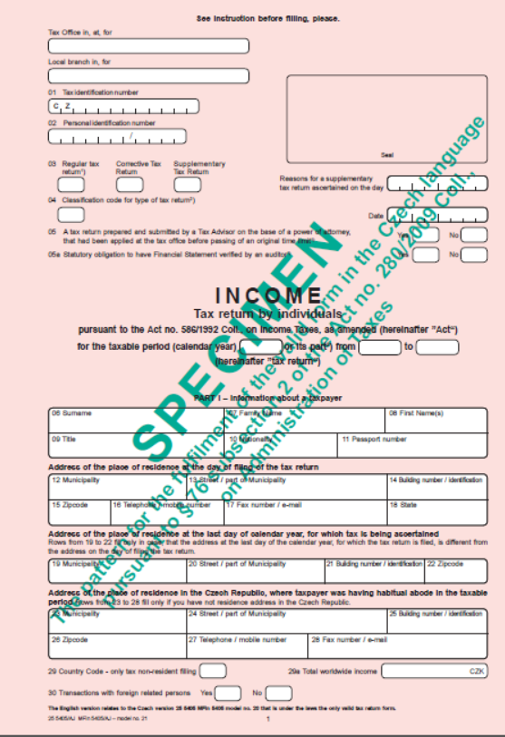
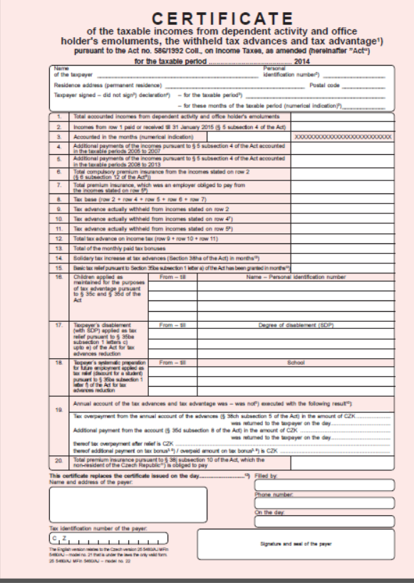
Forms for IncomeTax Return for 2020 https://www.financnisprava.cz/cs/danove-tiskopisy/databaze-aktualnich-danovych-tiskopisu

Slide 18
Tax Declaration for 2021 at UCT Prague
For those who are employed at UCT Prague only – any type of working contract
If you want your payroll accountat to apply a basic tax reliefs on your gross salary every month in 2021 - download a form „Statement payer of income tax“ from the Okbase Attendance System (see Slide 2)
PROHLÁŠENÍ poplatníka daně z příjmů fyzických osob ze závislé činnosti pro zdaňovací období 2021 = Declaration of the taxpayer liable to personal income tax from dependent activity for tax period 2021
Could you fill it in, sign and deliver to Personnel department - until January 31, 2021 or ASAP

Slide 19
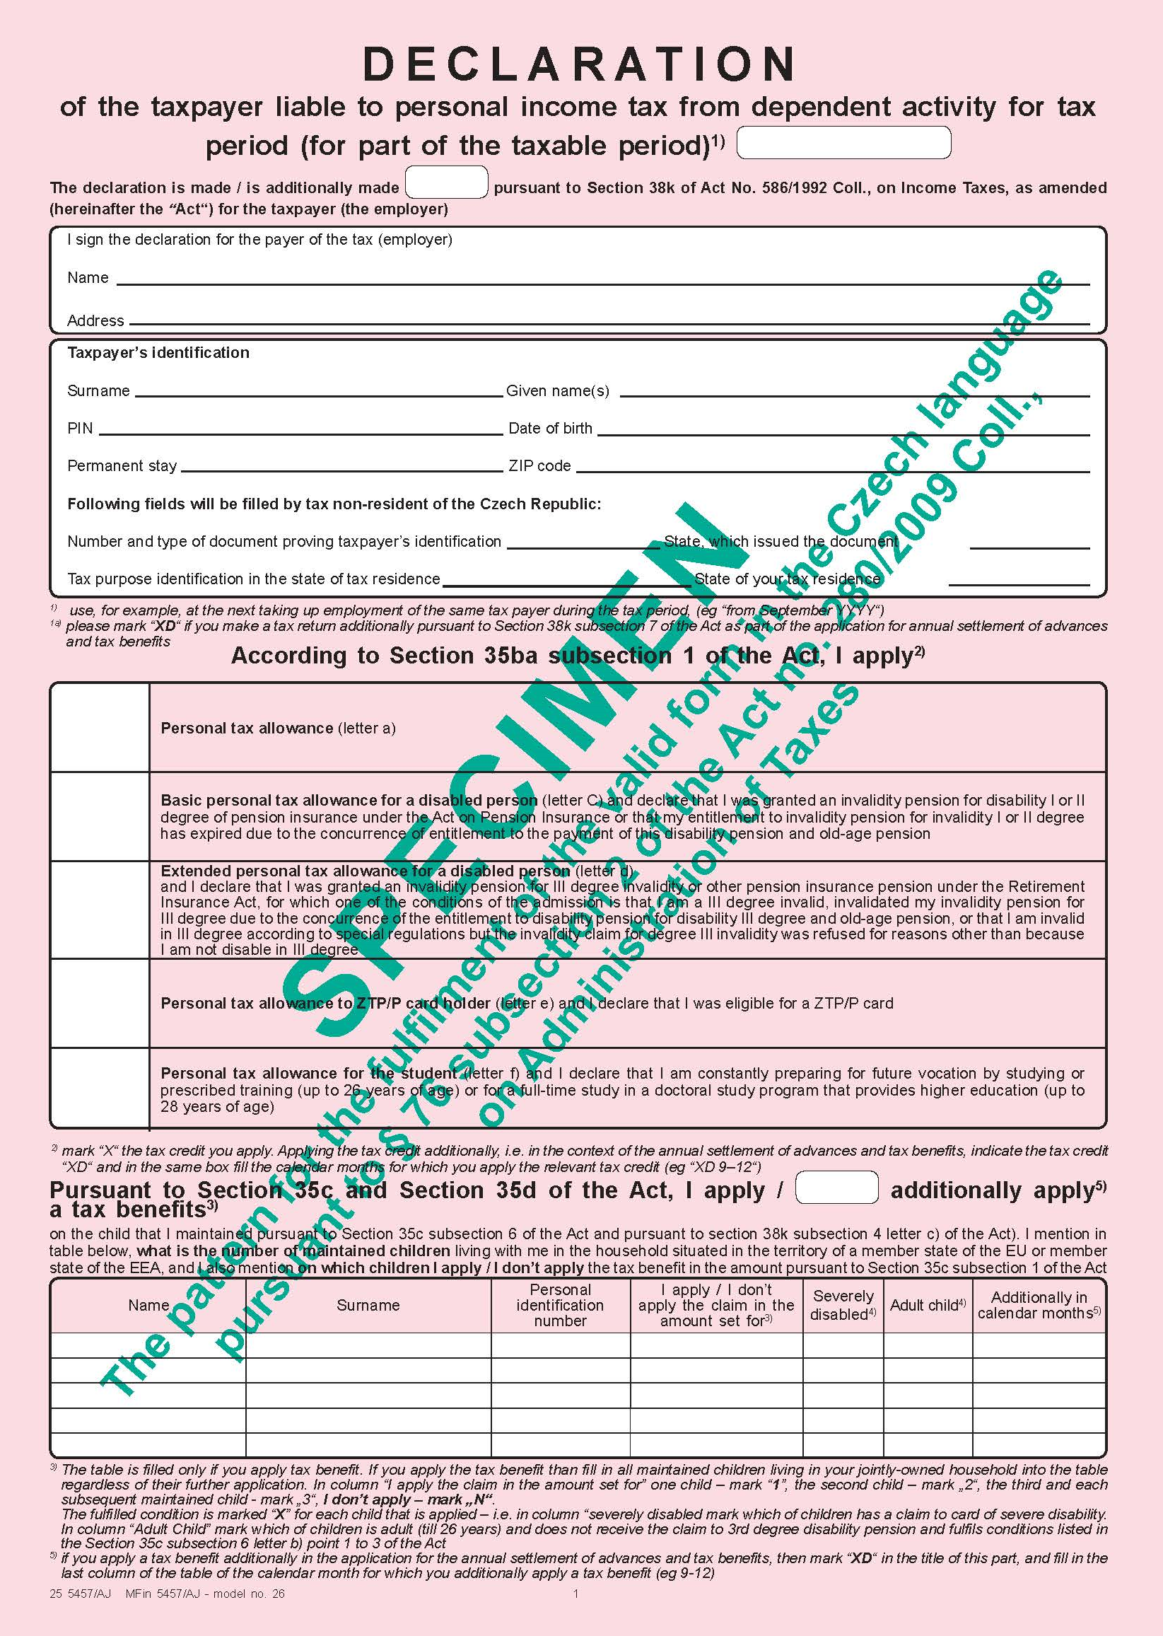
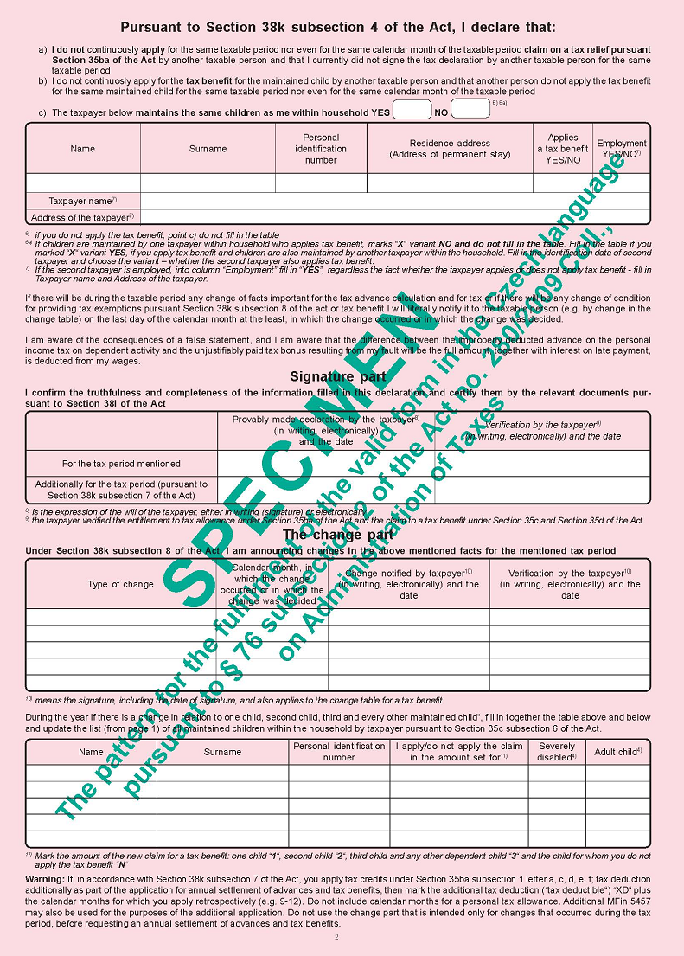
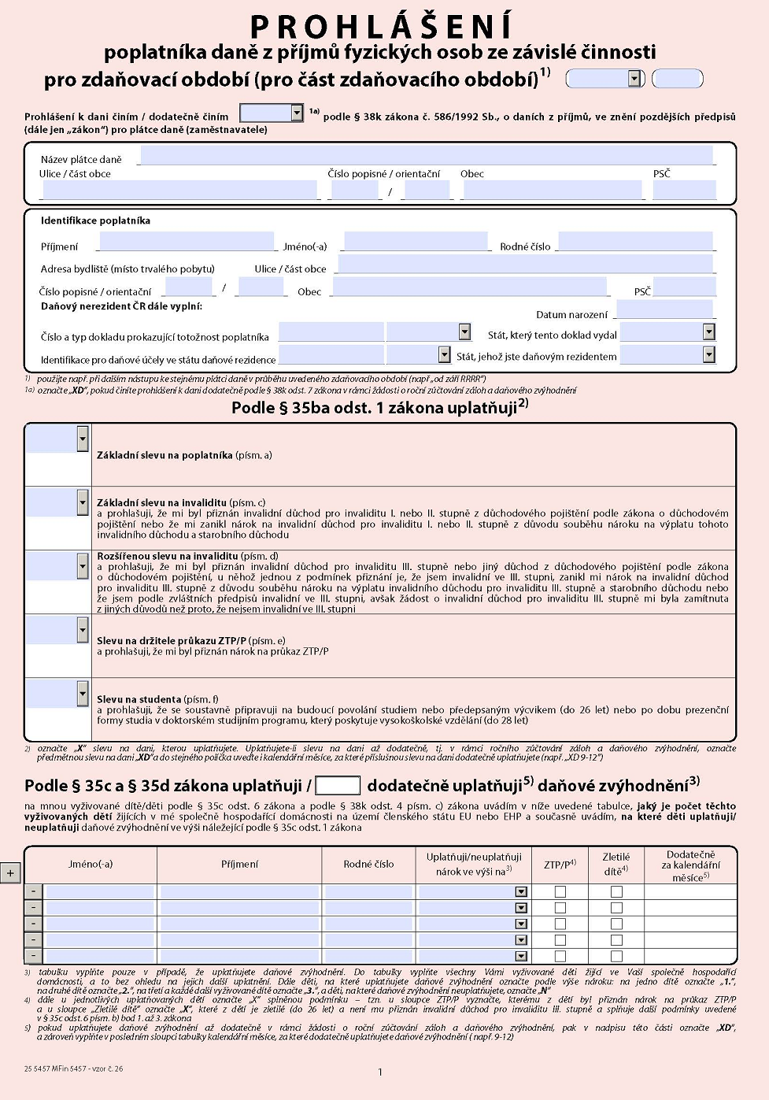
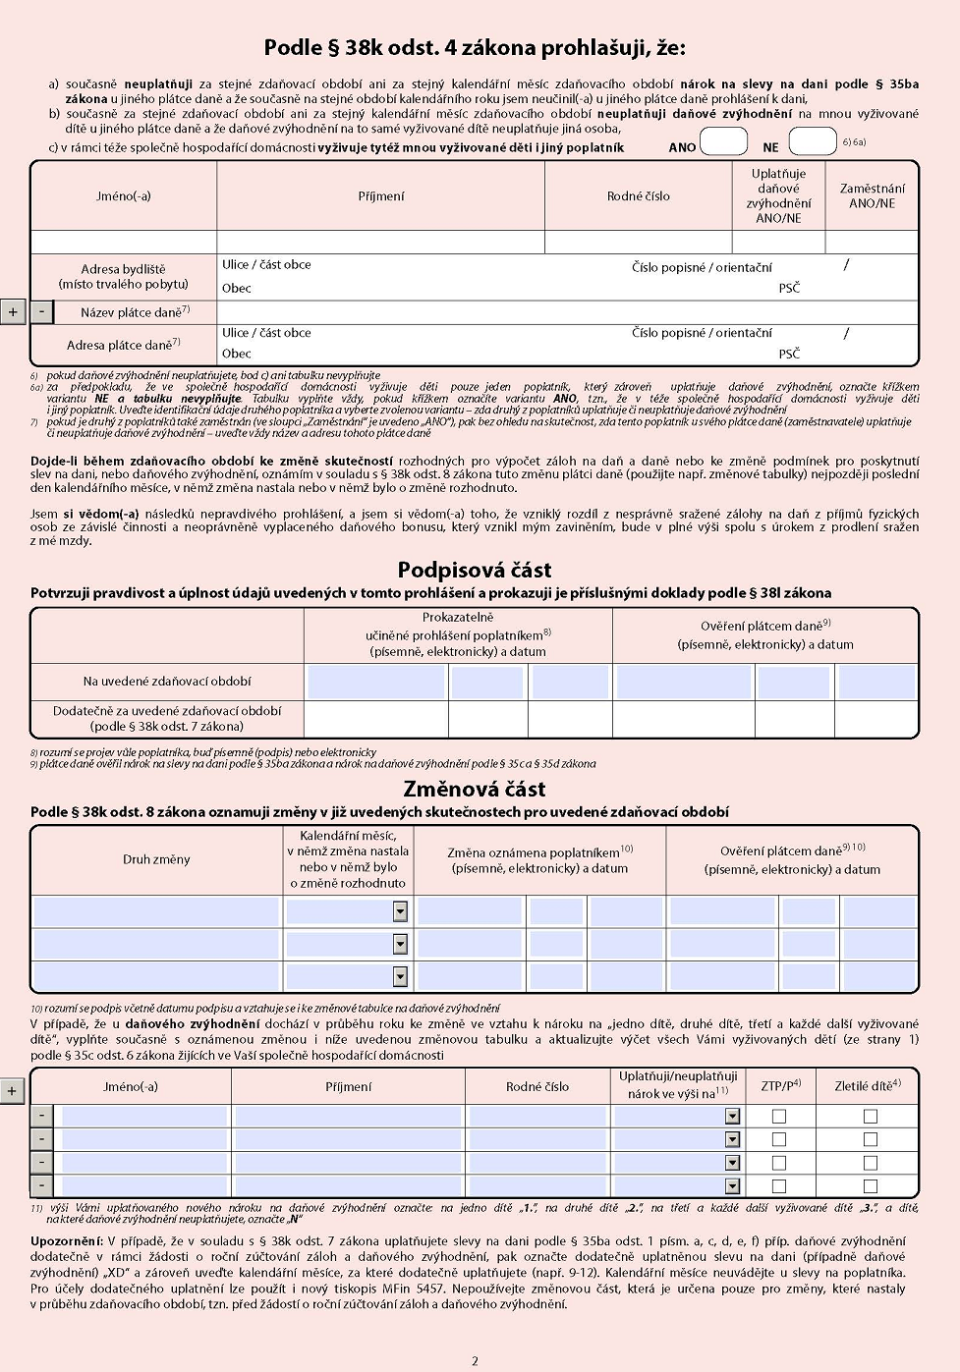
DECLARATION of the taxpayer liable to personal income tax from dependent activity for tax period 2021
Fill in, indicate if you have other claims for tax benefits, sign and deliver to the HR Dpt. by 31.1.2021
Prohlášení poplatníka daně z příjmů fyzických osob ze závislé činnosti na rok 2021
Vyplň, doplň pokud máte další nároky na zvýhodnění, podepište a dodejte na PO do 31.1.2021
Date + signature

Slide 20
Good news for 2021 !!!
The income tax remains 15% but it will be calculated from the Gross Salary (no more from the super gross salary)
Basic Tax Relief is increased from 24 840 CZK to 27 840 CZK per year
Per month it is increasing from 2 070 CZK to 2320 CZK
Example of net salary calculation
Gross salary 30 000 CZK/month
Net salary after application of a basic tax relief
In 2020 = 30 000 – 3 300 - (30 000*1,338)*0,15 – 2 070 = 18 609 CZK
In 2021 = 30 000 – 3 300 – 30 000*0,15 – 2 320 = 19 880 CZK
Difference 1 271 CZK in your favor ☺

Slide 21
Useful Web Pages
Intranet UCT Prague – information for employees (taxes) https://intranet.vscht.cz/human-resources/information-for-employees
Act 586/1992 Coll https://www.zakonyprolidi.cz/cs/1992-586#cast3
Overview of bilateral conventions on avoidance of double taxation
https://www.mfcr.cz/cs/legislativa/dvoji-zdaneni/prehled-platnych-smluv
KPMG https://home.kpmg/xx/en/home/insights/2014/01/czech-republic-income-tax.html
Accace 2021 Tax Guideline for the Czech Republic https://accace.com/tax-guideline-for-the-czech-republic/
Financial Administration of the Czech Republic https://www.financnisprava.cz/en/tax-forms/forms-and-information/personal-income-tax
Addresses of Financial (Tax) Offices in Prague https://www.financnisprava.cz/cs/financni-sprava/organy-financni-spravy/financni-urady/app/urad-kontakt/2000

Slide 22
Thank you for your attention
Ing. Anna Mittnerová
Anna.mittnerová@vscht.cz
UCT Prague, Department of International Relations
VŠCHT Praha , Zahraniční oddělení
B Building, Room S09a
Uveďte původ, Neužívejte komerčně, CC BY-NC

