Slide 1
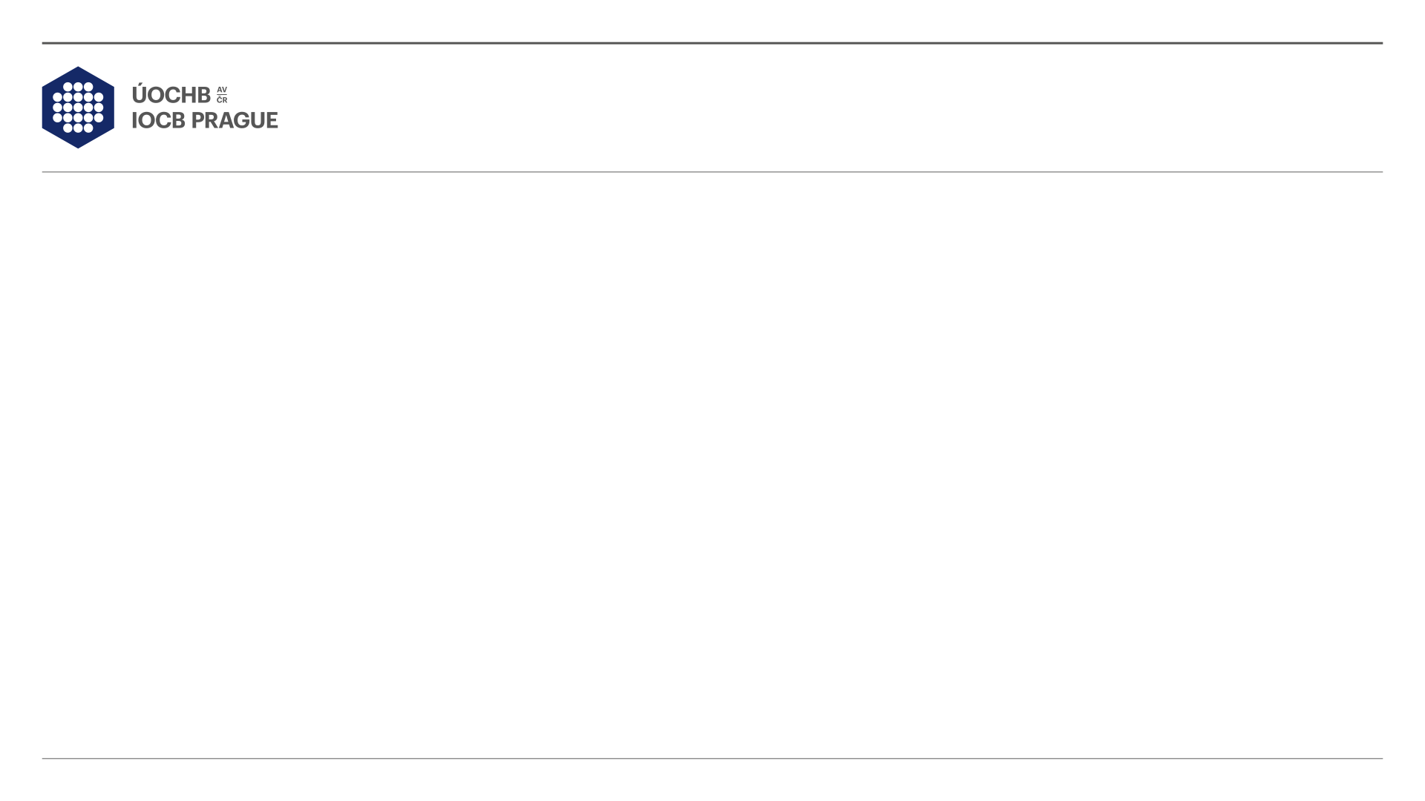
Fluoroalkylated hypervalent iodine reagents and their use in thiol bioconjugation
Iveta Klimánková| 6.6.2019

Slide 2
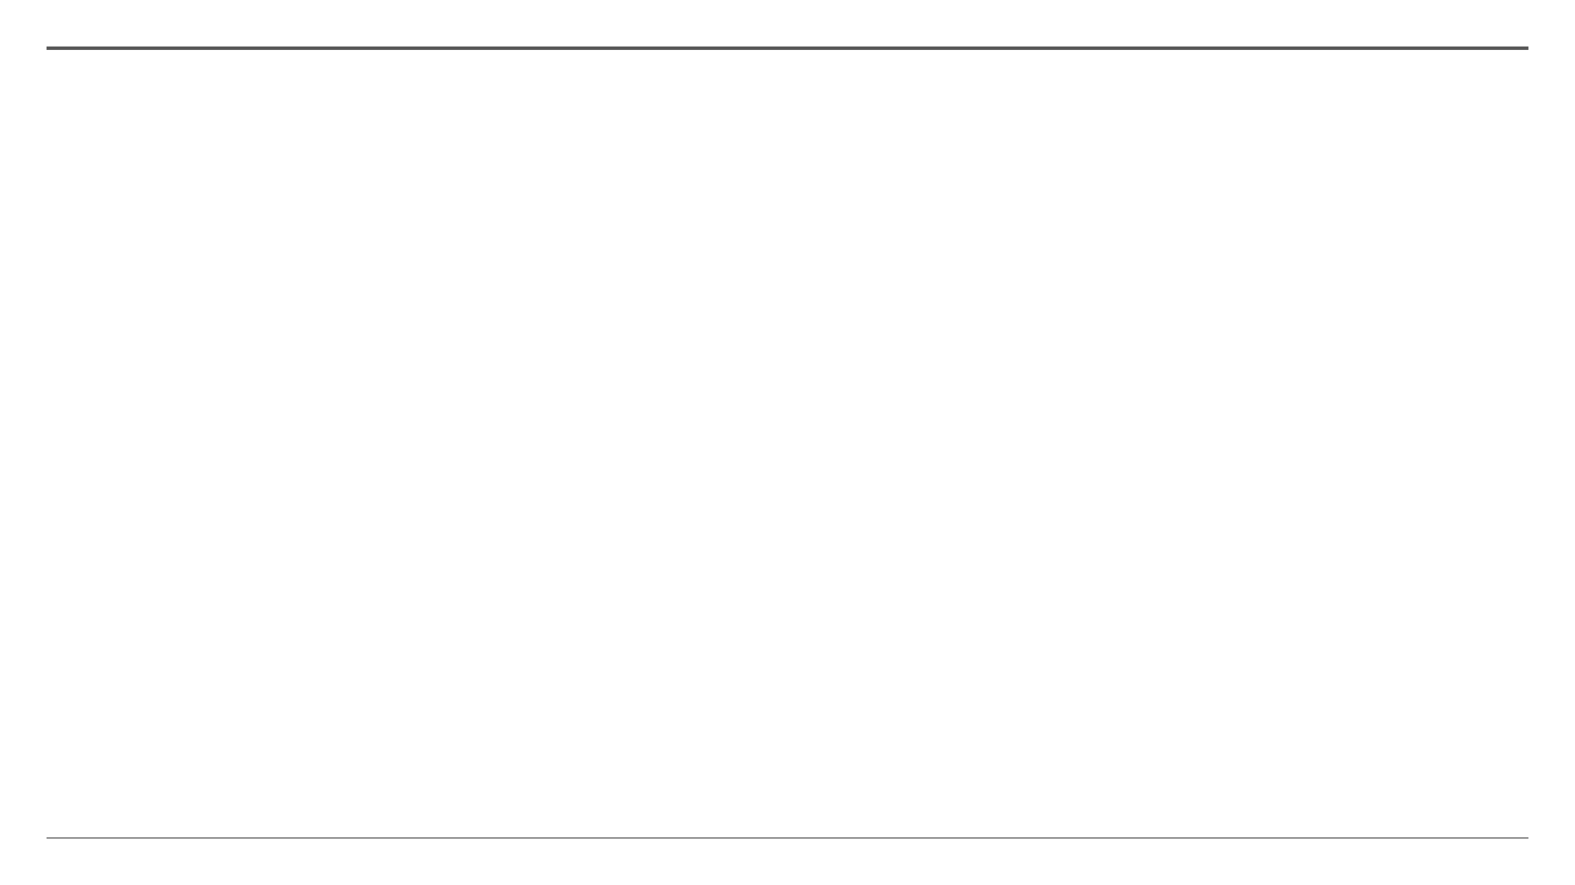
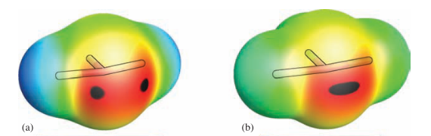
Hypervalent iodine reagents
2
1) Oxidation reagents:
Hypervalent λ³ - iodanes
T-shape
3cb bond
Nonclasical σ-hole
2) Transfer reagents:
a) IH₃; b) IF₃
Cyclic structure – enhanced the stability
H. P. D. E. Magalhães, O. Sala, H. P. Lüthi, 2018, pp. 1–28.
D. P. Hari, P. Caramenti, J. Waser, Acc. Chem. Res. 2018, 51, 3212–3225.

Slide 3
3
Fluoroalkylated hypervalent iodine regents and their reactivity
No reaction with amines and carboxylates
Reaction with alcohols – harsh conditions
Charpentier, J.; Früh, N.; Togni, A., Chem. Rev. 2015, 115 (2), 650-682.
Matoušek, V.; Václavík, J.; Hájek, P.; Charpentier, J.; Blastik, Z. E.; Pietrasiak, E.; Budinská, A.; Togni, A.; Beier, P., Chem. Eur. J. 2016, 22 (1), 417-424.

Slide 4
Reaction with thiols
4
I. Kieltsch, P. Eisenberger, A. Togni, Angew. Chemie Int. Ed. 2007, 46, 754–757.
V. Matoušek, J. Václavík, P. Hájek, J. Charpentier, Z. E. Blastik, E. Pietrasiak, A. Budinská, A. Togni, P. Beier, Chem. - A Eur. J. 2016, 22, 417–424.
S. Capone, I. Kieltsch, O. Flögel, G. Lelais, A. Togni, D. Seebach, Helv. Chim. Acta 2008, 91, 2035–2056.

Slide 5
Late stage fluoroalkylation of thiols by hypervalent iodine reagents
5
M. A. Danielson, J. J. Falke, Annu Rev Biophys Biomol Struct. 1996, 25, 163–195.
E. N. G. Marsh, Acc. Chem. Res. 2014, 47, 2878–2886.
L. K. Charkoudian, C. W. Liu, S. Capone, S. Kapur, D. E. Cane, A. Togni, D. Seebach, C. Khosla, Protein Sci. 2011, 20, 1244–1255.
J. Václavík, R. Zschoche, I. Klimánková, V. Matoušek, P. Beier, D. Hilvert, A. Togni, Chem. - A Eur. J. 2017, 23, 6490–6494.

Slide 6
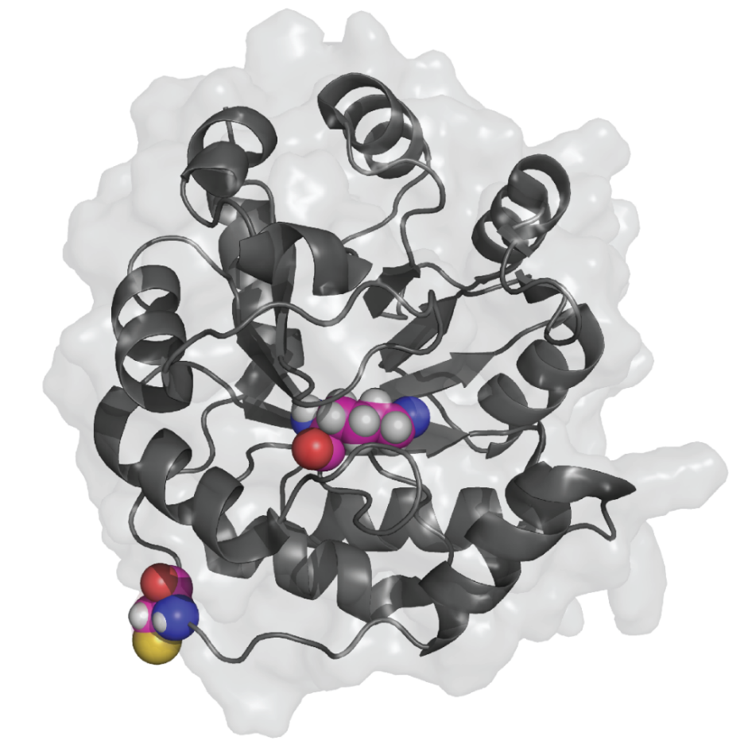
Labeling of Retro-aldolase RA95.5-8 S25C K210M (RA-CM)
6
Lys83 in hydrophobic pocket
responsible for catalytic activity of the enzyme
Cys25
J. Václavík, R. Zschoche, I. Klimánková, V. Matoušek, P. Beier, D. Hilvert, A. Togni, Chem. - A Eur. J. 2017, 23, 6490–6494.

Slide 7
Reagents used for labeling RA-CM
7
J. Václavík, R. Zschoche, I. Klimánková, V. Matoušek, P. Beier, D. Hilvert, A. Togni, Chem. - A Eur. J. 2017, 23, 6490–6494.

Slide 8

Labeling of RA-CM
8
+
J. Václavík, R. Zschoche, I. Klimánková, V. Matoušek, P. Beier, D. Hilvert, A. Togni, Chem. - A Eur. J. 2017, 23, 6490–6494.

Slide 9
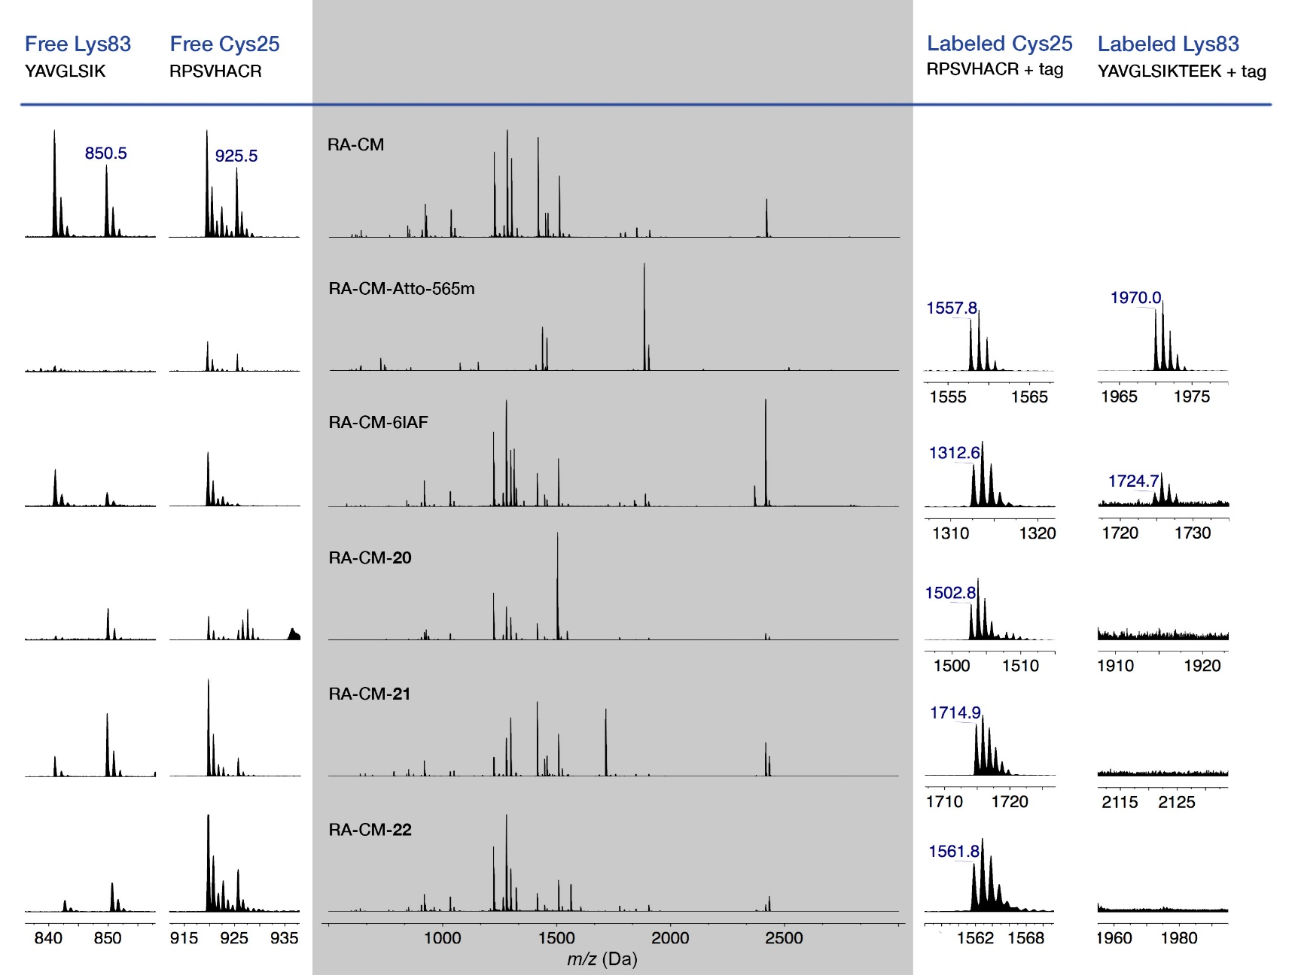
MALDI spectra after trypsin digestion of labeled RA-CM
9
J. Václavík, R. Zschoche, I. Klimánková, V. Matoušek, P. Beier, D. Hilvert, A. Togni, Chem. - A Eur. J. 2017, 23, 6490–6494.

Slide 10
Fluorolkylation of cysteine
10
Reagent | Precipitation | pH | co-so | 1 [%] | 2 [%]
Ph1 | Yes | 4 | DMSO | 9 | 8
Ph2 | Yes | 4 | DMSO | 6 | 6
Ph2 | Yes | 8 | DMSO | 20 | 2
Ph1-AcCl | Yes | 4 | DMSO | 18 | 3
Ph1-AcCl | Yes | 8 | DMSO | 28 | 2
NMT1 | No | 4 | CH₃CN | 98 | 9
NMT1 | No | 7 | CH₃CN | 91 | 4
NMT2 | No | 4 | CH₃CN | 13 | 8
NMT2 | No | 7 | CH₃CN | 94 | 3
¹⁹F NMR yield to internal CF₃COOK or CF₃CH₂OH

Slide 11
Reactivity of watersoluble reagents
11
pH | time | 4 [%] | 3 F⁻ or 3 HF [%] | 3 [%]
4 | 10 min | 94 | 52 | 0
7 | 10 min | 99 | 18 | 13
8 | 10 min | 97 | 17 | 13
¹⁹F NMR yield to internal CF₃COOK

Slide 12
Fluoroalkylation of DAVACAK
12
The reaction mixture was further analyzed by LC-MS (I - Class - SYNAPT G2).
Lower concentration (cysteine 30 mM, DAVACAK 0.6 – 1.5 mM)
Higher excess of reagent (10 eq. – 30 eq.)
Identification of nonfluorinated side products

Slide 13
Fluoroalkylation of DAVACAK
13

Slide 14
Fluoroalkylation of DAVACAK
14
 | c = 0.15mM [AUC] | c = 1.5mM [AUC]
5 | 300 | 170
6 | 600 | 3460
 | 10² [AUC]
 | pH = 4 |  |  |  |  | pH = 8
 | Blank | NMT1 1 h | NMT1 24 h | NMT2 1 h | NMT2 24 h | Blank | NMT1 1 h | NMT1 24 h | NMT2 1 h | NMT2 24 h
5 | 137 | 25 | 21 | 25 | 22 | 121 | 39 | 21 | 14 | 8
6 | 0 | 29 | 31 | 14 | 15 | 0 | 40 | 36 | 136 | 106

Slide 15
Fluoroalkylation of DAVACAK – Formation of oxidized side products
15
Decomposition of 21
 | 10² [AUC]
 | pH = 4 |  |  |  |  | pH = 8
 | Blank | NMT1 1 h | NMT1 24 h | NMT2 1 h | NMT2 24 h | Blank | NMT1 1 h | NMT1 24 h | NMT2 1 h | NMT2 24 h
5 | 137 | 25 | 21 | 25 | 22 | 121 | 39 | 21 | 14 | 8
6 | 0 | 29 | 31 | 14 | 15 | 0 | 40 | 36 | 136 | 106
7 | 0 | 11 | 12 | 10 | 12 | 0 | 0.5 | 0.7 | 0 | 0.5
8 | 1 | 20 | 22 | 35 | 38 | 1 | 6 | 8 | 6 | 7
9 | 0 | 18 | 12 | 5 | 5 | 0 | 0 | 0 | 0 | 0
10 | 0 | 28 | 23 | 28 | 22 | 2 | 7 | 6 | 5 | 2

Slide 16
Reaction in H₂O¹⁸
16

Slide 17
Reaction in H₂O¹⁸
17
 | Blank 10² [AUC] | NMT1 1 h 10² [AUC] | NMT1 24 h 10² [AUC] | NMT2 1 h 10² [AUC] | NMT2 24 h 10² [AUC]
20b | 0 | 29 | 31 | 14 | 15
21b | 0 | 11 | 12 | 10 | 12

Slide 18
Fluoroalkylation of DAVACAK – Formation of N-acylated side products
18
Unselective – functional group is transfer also on Lysine, N-term…
 | 10² [AUC]
 | pH = 4 |  |  |  |  | pH = 8
 | Blank | NMT1 1 h | NMT1 24 h | NMT2 1 h | NMT2 24 h | Blank | NMT1 1 h | NMT1 24 h | NMT2 1 h | NMT2 24 h
5 | 137 | 25 | 21 | 25 | 22 | 121 | 39 | 21 | 14 | 8
6 | 0 | 29 | 31 | 14 | 15 | 0 | 40 | 36 | 136 | 106
11 | 0 | 0 | 0 | 0 | 0 | 0 | 4 | 5 | 5 | 31
12 | 0 | 0 | 0 | 0 | 0 | 0 | 0.5 | 1 | 0.5 | 0.5
13 | 0 | 0 | 0 | 0 | 0 | 0 | 15 | 16 | 7 | 10

Slide 19
Fluoroalkylation of DAVACAK – Formation of N-acylated side products
19
Reagent | Precipitation | pH | co-so | 1 [%] | 2 [%]
Ph1 | Yes | 4 | DMSO | 9 | 8
Ph2 | Yes | 4 | DMSO | 6 | 6
Ph2 | Yes | 8 | DMSO | 20 | 2
Ph1-AcCl | Yes | 4 | DMSO | 18 | 3
Ph1-AcCl | Yes | 8 | DMSO | 28 | 2
NMT1 | No | 4 | CH₃CN | 98 | 9
NMT1 | No | 7 | CH₃CN | 91 | 4
NMT2 | No | 4 | CH₃CN | 13 | 8
NMT2 | No | 7 | CH₃CN | 94 | 3

Slide 20
Reaction in H₂O¹⁸
20

Slide 21
21
Conclusion
Thiol fluoroalkylation by hypervalent iodine reagent is usefull:
  In organic solvents at low temperature
2. In water at rt with water soluble reagents
The excess of reagent, lower concenration and longer reaction time are unsuitable for this reaction,
due to the formation of side products

Slide 22
Radical fluoroalkylation with hypervalent iodine reagents in aqueous media
22
Only solvent acesible aminoacids

Slide 23
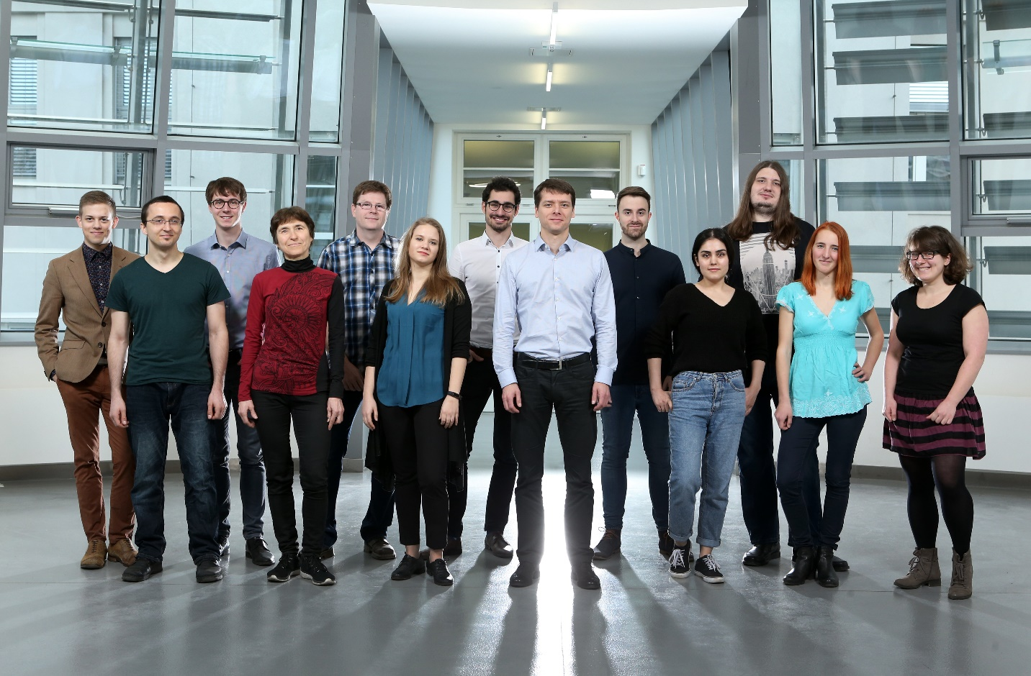



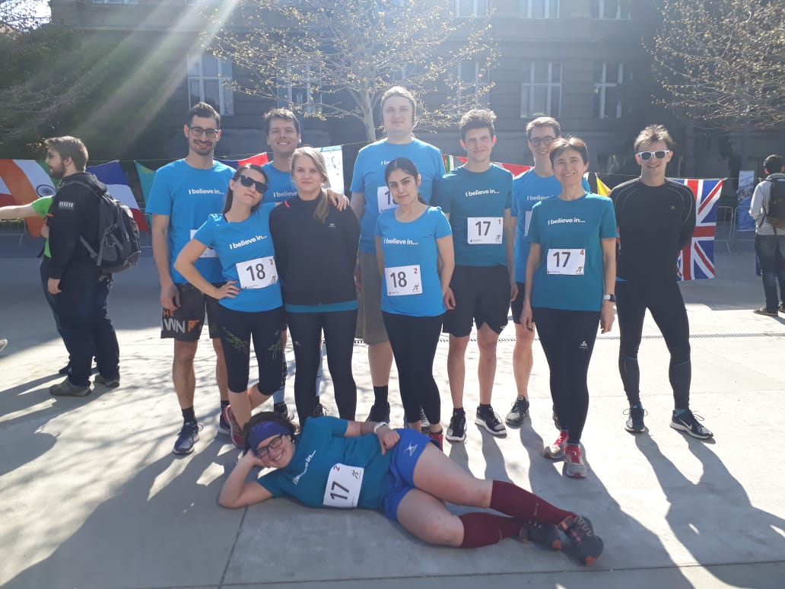
Acknowledgement
23
Petr Beier
Jiří Václavík, Sonia Rahimi
Martin Hubálek and Michal Korecký from MS department
Václav Matoušek (CF Plus Chemicals)
IOCB Prague
Iveta Klimánková | 27.2.2019

