Slide 1

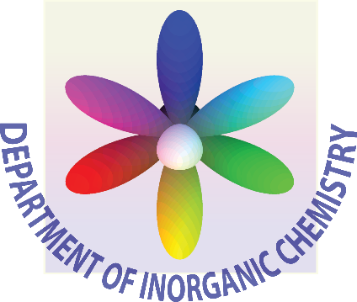

Electron pathways in proteins
Martin Pižl
3rd phd_post.doc club
UCT Prague
2.5. 2019
Department of Inorganic Chemistry, University of Chemistry and Technology, Prague, Technická 5, 166 28 Prague 6, Czech Republic
Department of Biophysical Chemistry, J. Heyrovský Institute of Physical Chemistry of CAS, v.v.i, Dolejškova 3, 182 23 Prague 8, Czech Republic

Slide 2

Outline
Introduction
ET in biology
Results
Experimental work
Concluding remarks
QM
Time-resolved spectroscopy
Azurin – Pseudomonas aeruginosa, probe

Slide 3
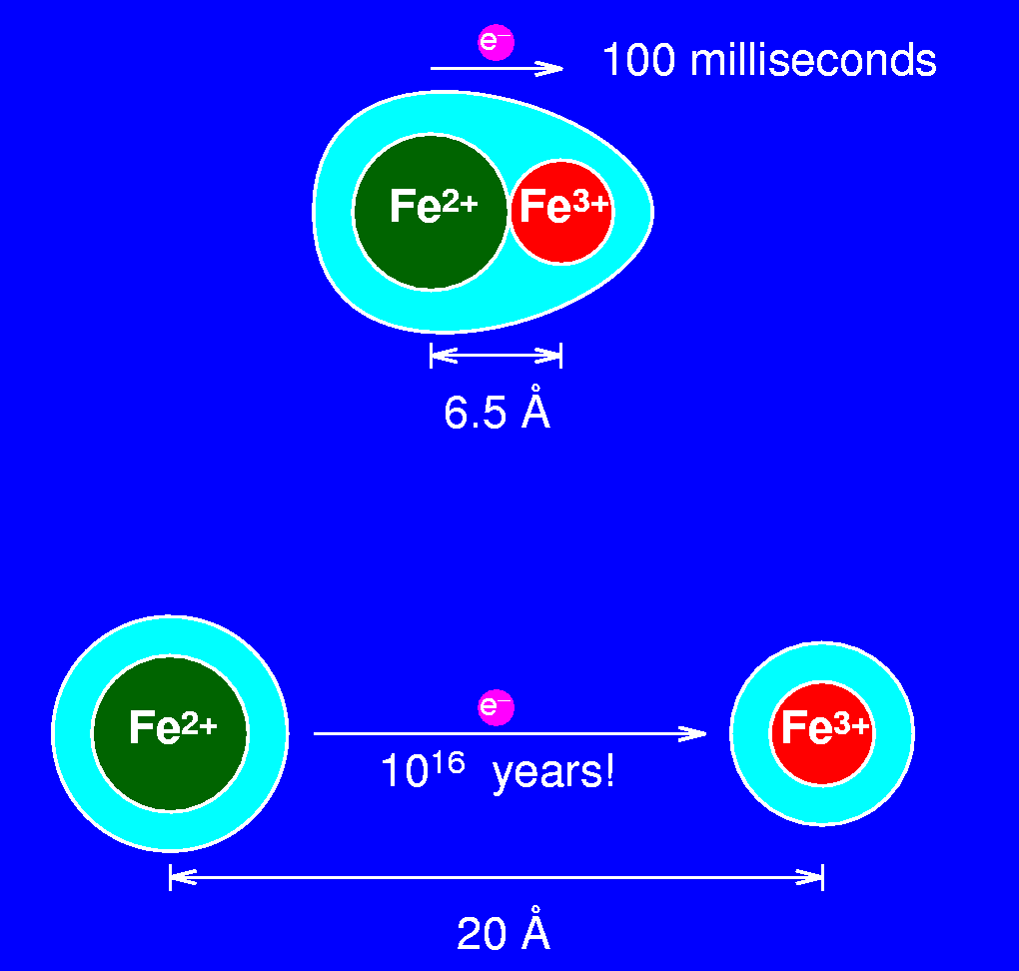
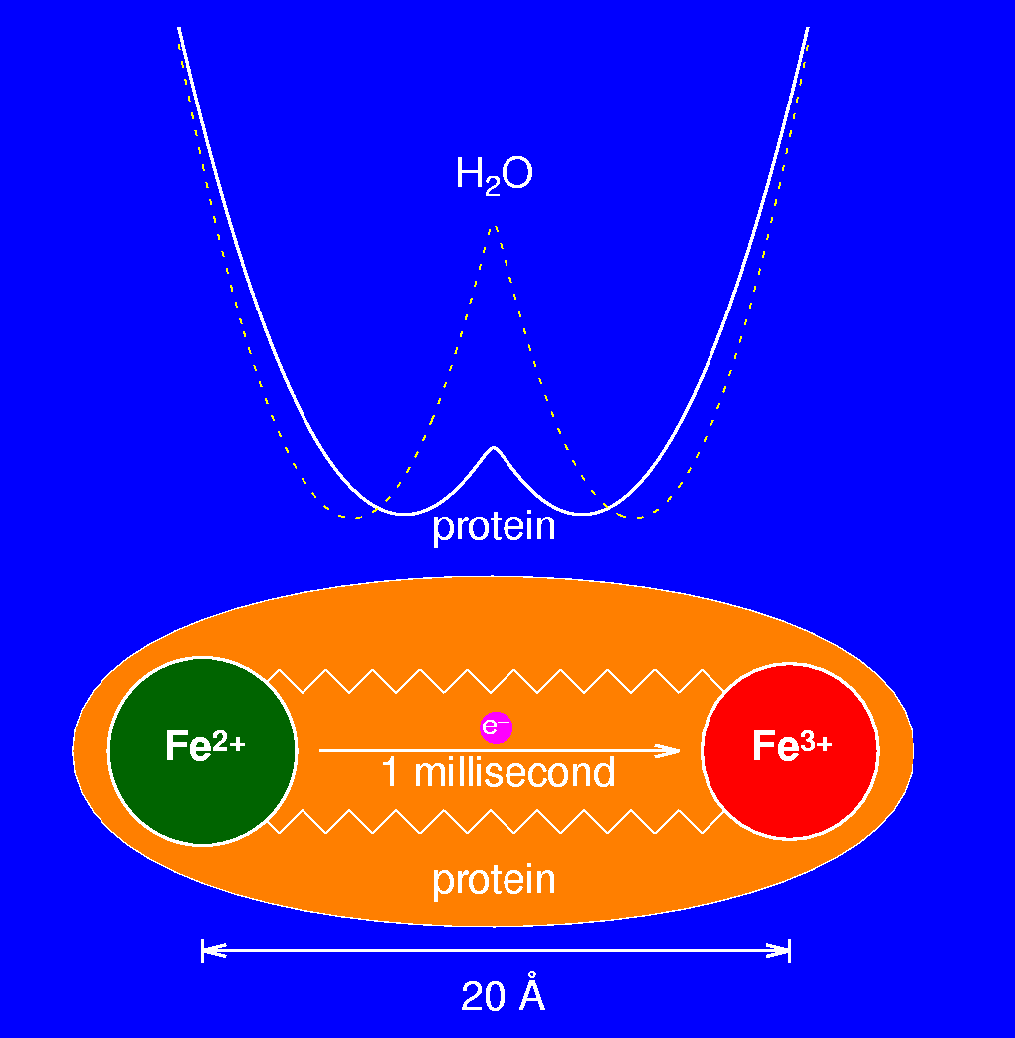
Electron transfer (ET) – an example
5x10⁴ years in water
Notes:
10¹⁶ years in vacuum
50,000 years in water

Slide 4
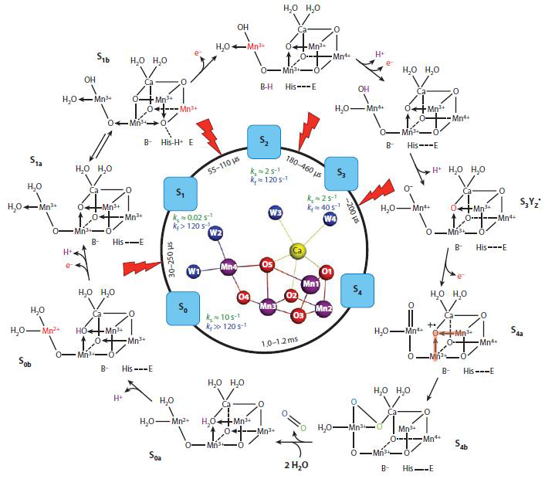
ET in biological systems
Electron transfer central to life, for example in:
• Bioenergetics:
• Respiration
• Photosynthesis
• Atom and group transfer reactions
• Nitrogen fixation
• Detoxifixation
• Gene regulation
• Signalling
• Collagen synthesis
• Steroid metabolism
• ……..
Oxidoreductases: enzymes that catalyse redox reactions
Require supply (or removal) of electrons commensurate with the
catalytic turnover: electron transferases
• Long-range electron transfer (ET)

Slide 5
3 types of redox centers:
Protein side chains:
Tryptophan: Trp → Trp^{•+} or Trp• + H⁺ + e–
ET acceleration (e.g. in peroxidase), DNA photolyase, etc.
Tyrosine: Tyr → Tyr• + H⁺ + e–
Electron transfer coupled with proton transfer, e.g. water oxidation in PSII,
ribonucleotide reductase, etc.
Cystein: 2 -SH → -S-S- +2H⁺ + 2e–
Mercuric ion reductase, xanthine oxidase, thioredoxine, …
2. Small molecules:
NAD⁺ + H⁺ + e– → NADH
Quinones: 1 or 2 e–/H⁺ carriers
3. Redox cofactors:
Redox-active groups inside proteins (= redox proteins)
a) Electron carriers = electron transferases
b) Activators: ET coupled with small molecule activation/transformation
Redox proteins often form protein complexes (multisite enzymes) where
electron transferases work in concert with redox activators
Notes:
Note: EPR, Trp or Tyr -> Phe mutation

Slide 6
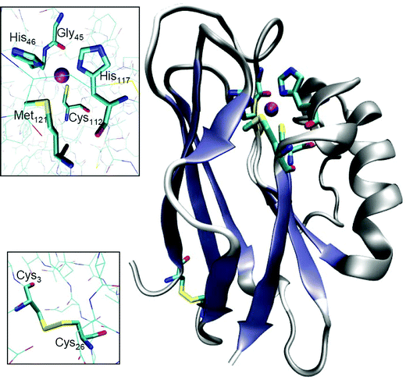
Azurin – Pseudomonas aeruginosa
bacterial blue copper protein
moderates single-electron transfer by oxidation-reduction between Cu(I) and Cu(II)
nitrogen cycle
oxidative deamination of primary amines

Slide 7
Probe?
proteins, polymers,
binding sites,
wires, …
DNA, wires,
polymer backbones
binding sites, …
Re^{I}(L)(CO)₃(N,N)
Stable and synthetically flexible complexes,
emissive, excited-state character and dynamics depend on the environment,
strong photooxidants, photocatalysts,…

Slide 8
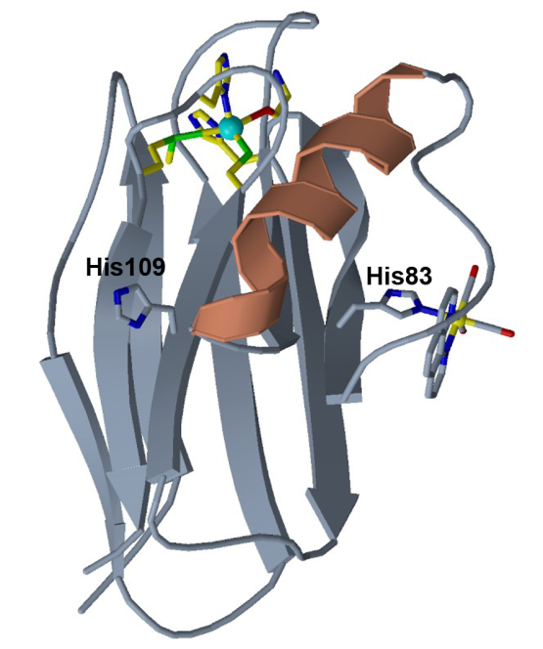
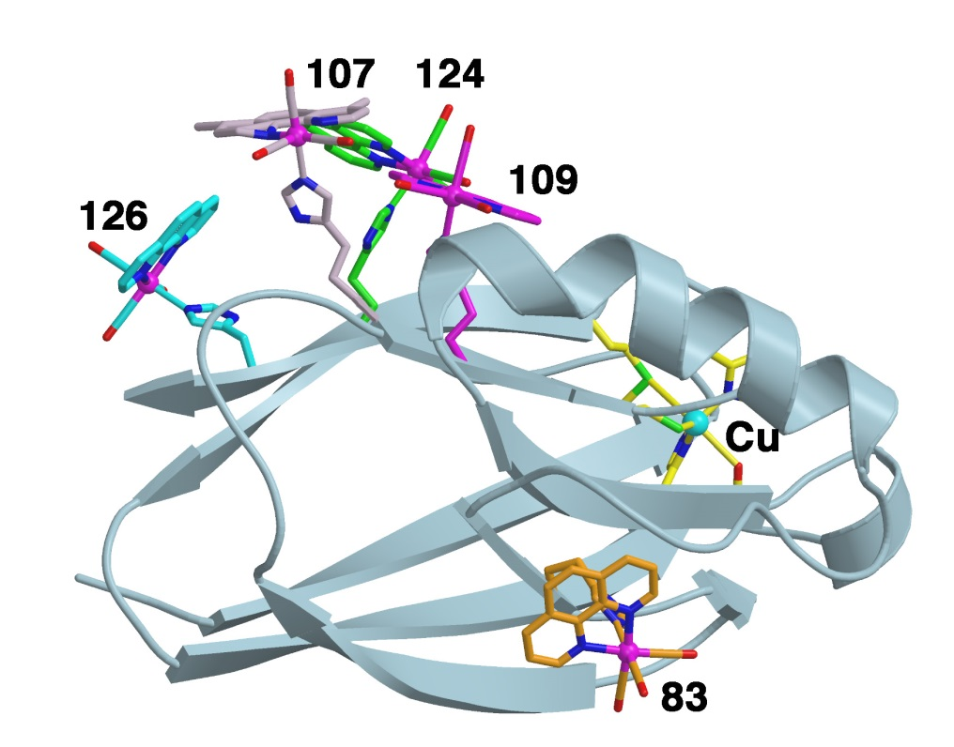
Azurin – Pseudomonas aeruginosa

Slide 9
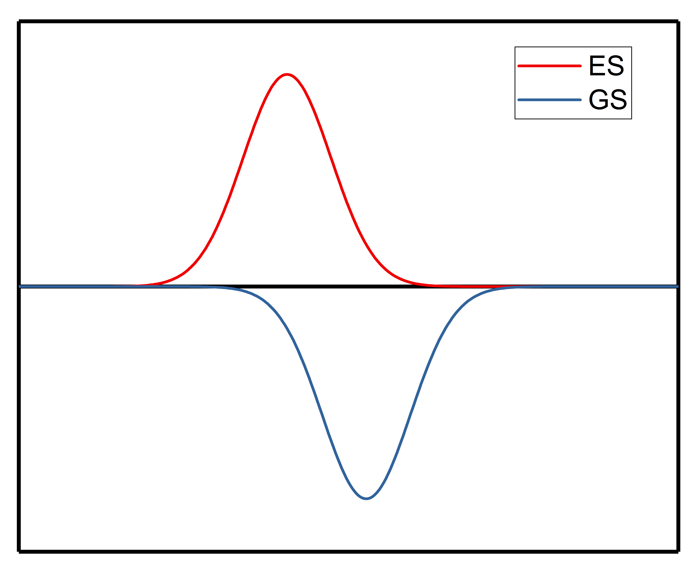
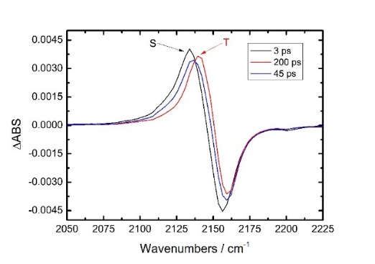
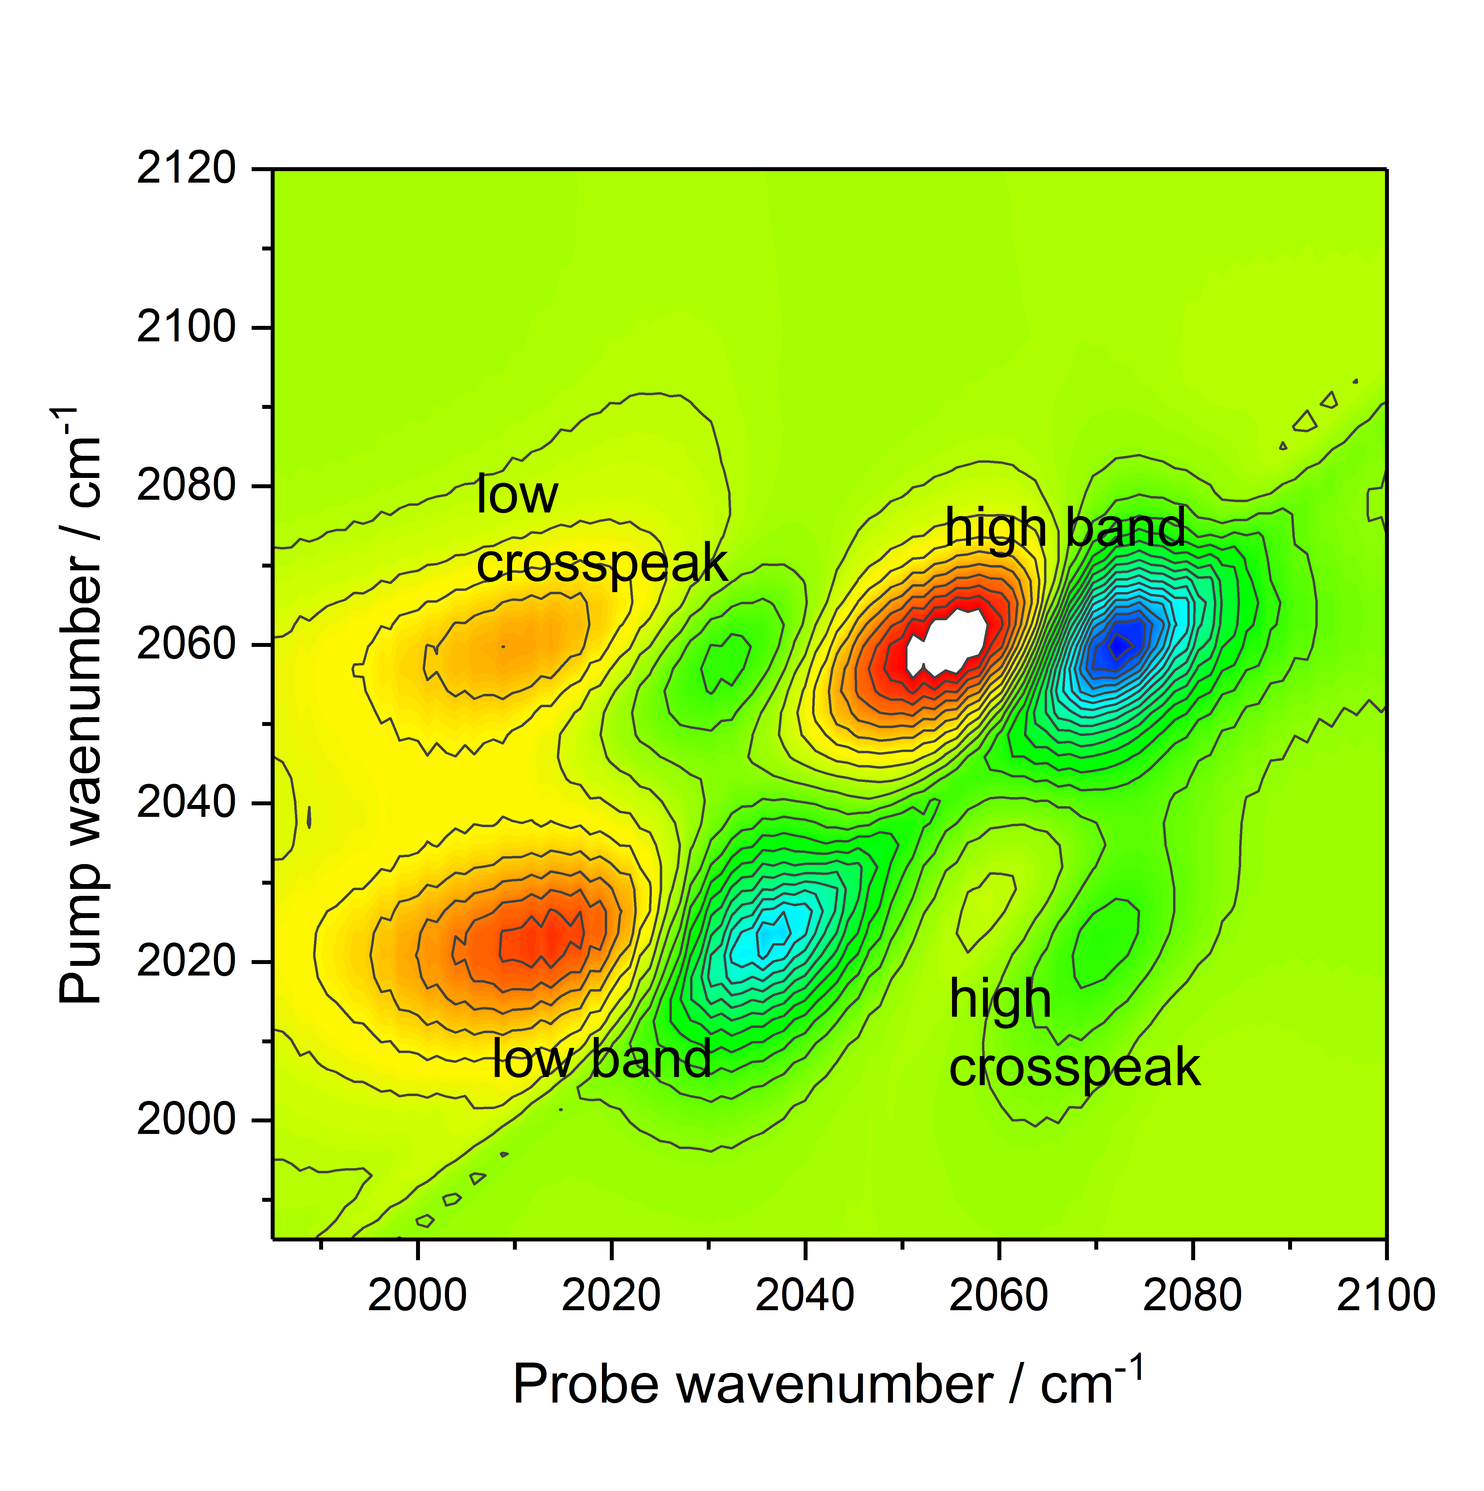
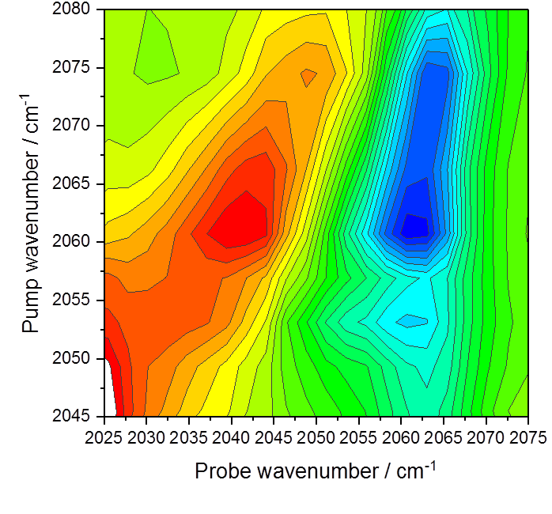
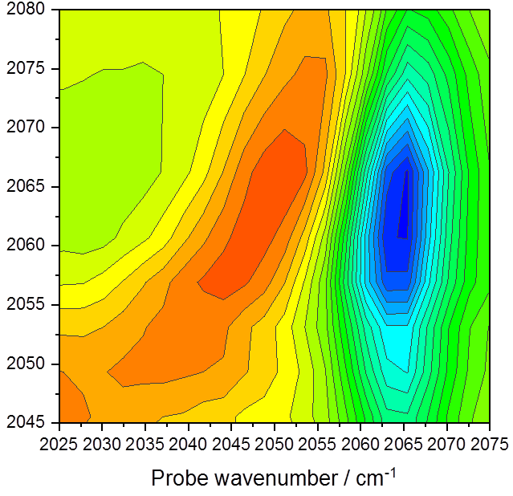
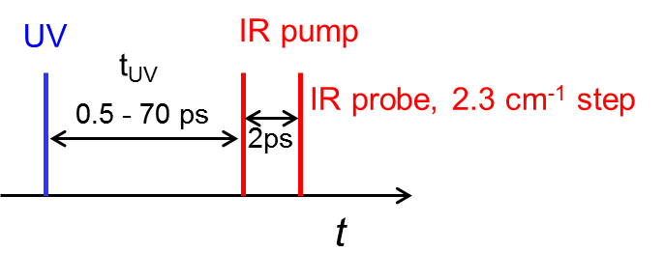
Time-resolved spectroscopy
Time-resolved IR (TRIR)
evolution of EES (pump) – UV-Vis
description of EES (probe) – IR
2-dimensional IR (2DIR)
evolution of VES (pump) – IR
description of VES (probe) – IR
Transient 2-dimensional IR (T-2DIR)
evolution of EES (pump) – UV-Vis
evolution of VES (pump) – IR
description of EES and VES (probe) – IR
2D-UV, TR-FSRS etc.
Important vibration - CO, CN
from fs to μs
Recording of spectrum in difference mode
ground-state (GS) spectrum => subtracted from the excited-state (ES) spectrum = > “bleaches” and “transients”

Slide 10
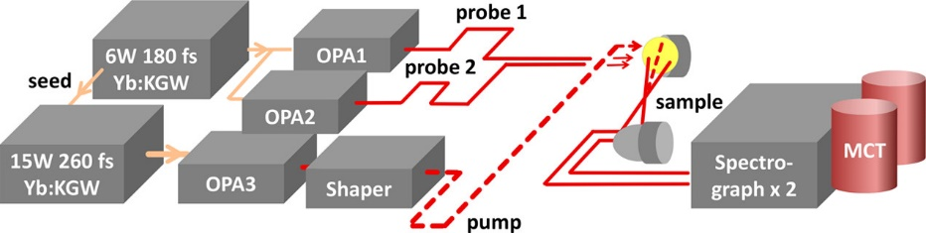
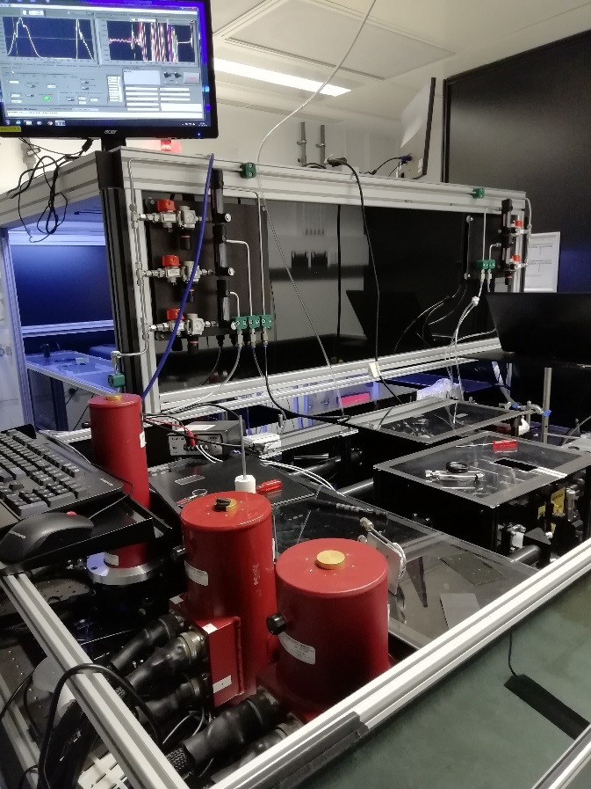
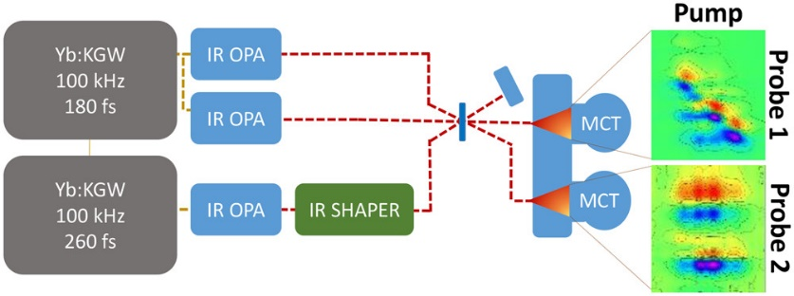

TR-spectroscopy – instrumentation of 2DIR
N. T. Hunt, Dalton Trans., 2014, 43, 17579.
P. M. Donaldson, G. M. Greetham, D. J. Shaw, A. W. Parker and M. Towrie, The Journal of Physical Chemistry A 2018, 122, 780-787.

Slide 11
Experimental results

Slide 12
Mutants of ReAz

Slide 13
Jablonski diagram of ReAz
χ ≤ 40 μM

Slide 14
ReAz - dimer
Interfacial region between chains A and D in the asymmetric unit of Re126WWCu^{II}, showing distances relevant to intermolecular ET. The four interfacialtryptophans form a “cage” with indole groups separated by less than 4 Å
Structure of Re126WWCu^{II} showing intramolecular distances between the redox cofactors

Slide 15
ReAz - dimer
EAS of Re126WWCu^{II} and Re126WWCu^{I} obtained by multiexponential global analysis of picosecond (bottom) and nanosecond (top) TRIR spectra using a sequential model.
IR DAS of Re126WWCu^{II} and Re126WWCu^{I} obtained by multiexponential global kinetics fitting of picosecond (bottom) and nanosecond (top) TRIR spectra. Negative and positive features correspond to signal rise and decay, respectively.
Arrows indicate the LCS early-time broadening and the ~1985 cm^{–1} shoulder.

Slide 16
Jablonski diagram of ReAz - dimer

Slide 17
Insight from theory?

Slide 18
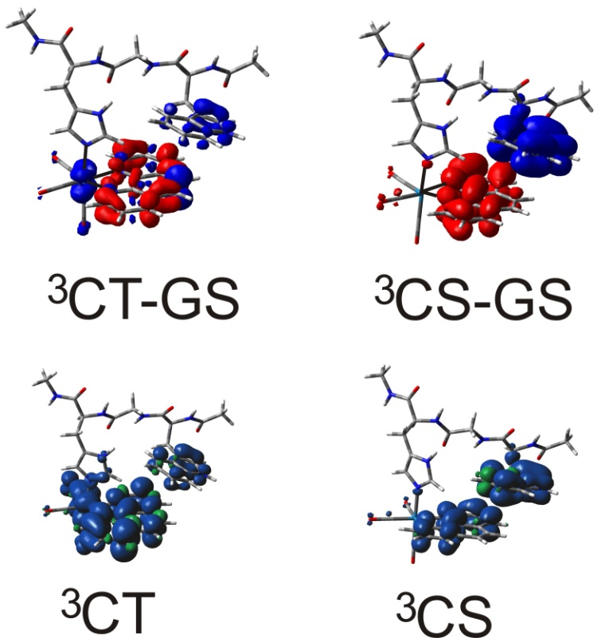
DFT calculations on Re(dmp)(W) model unit
GS
³CT
GS
³CS
Simulated IR spectra

Slide 19
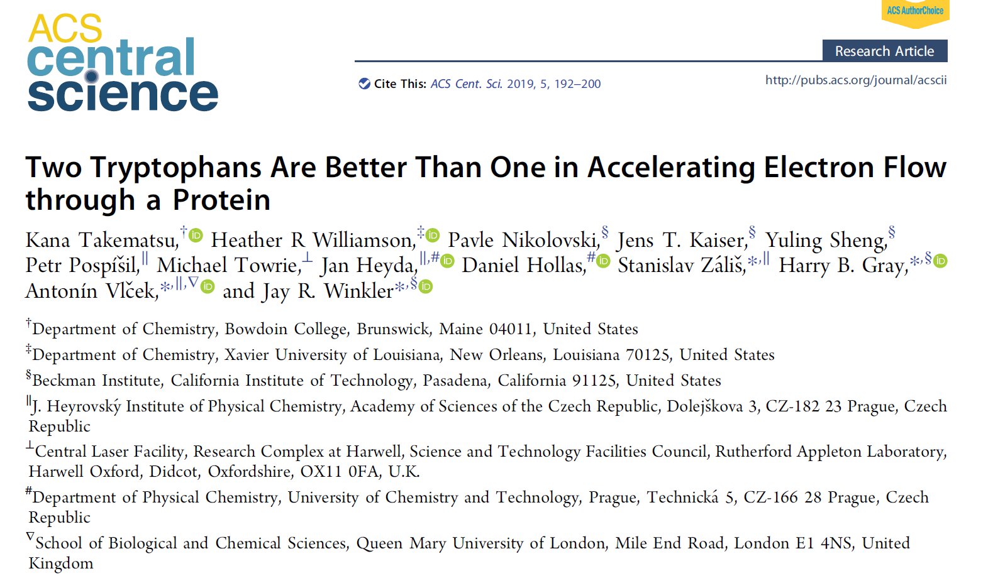
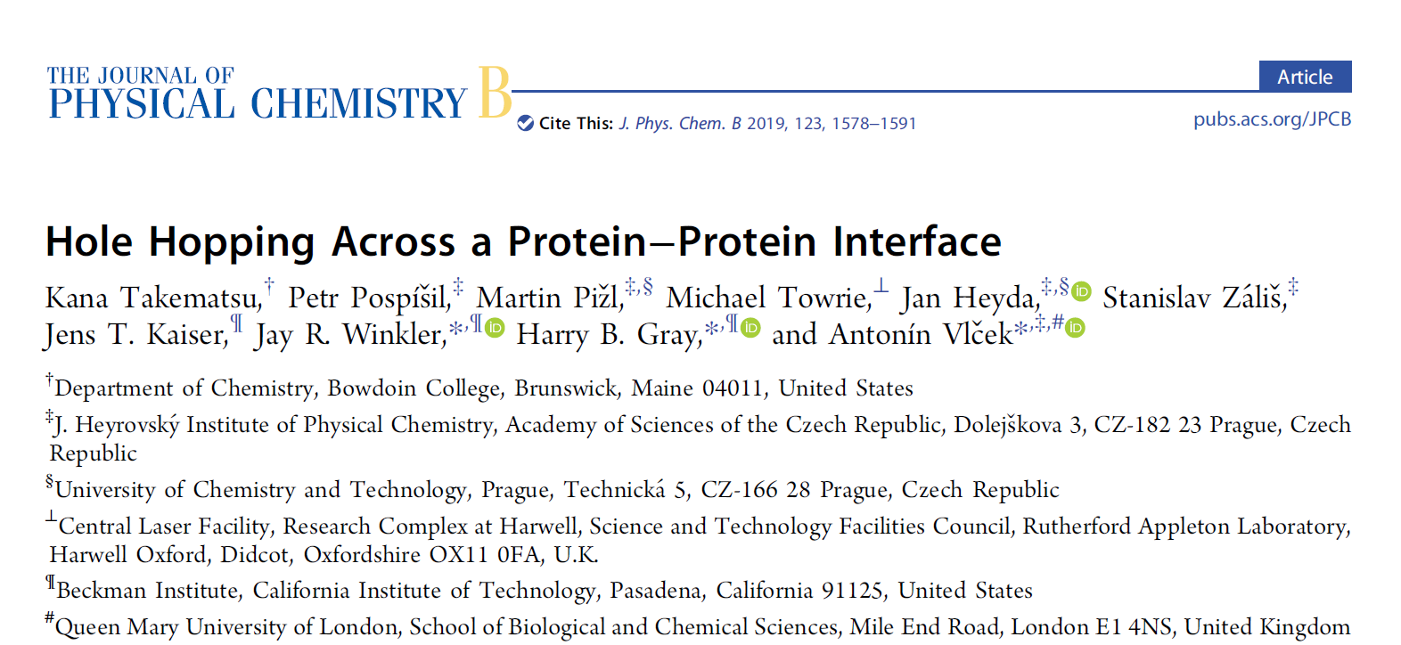
Conclusion

Slide 20

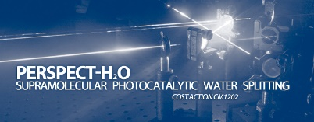
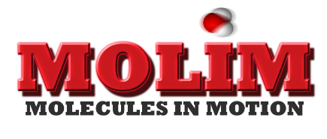
  Acknowledgements:
  Gray’s group (Caltech); Kaim’s group (Stuttgart); M. Guricová (UCT)
  Paul Donaldson, Greg Greetham, Mike Towrie (Harwell Campus, UK);
  J. Taylor, F. Hartl (Reading); A. Vlček (QMUL);
  M. Fuse, N. Tasinato, Ch. Cappelli, V. Barone (SNS Pisa)
  I. Hoskovcová (UCT) and S. Záliš (UFCH JH)
Financial support:
MŠMT LTC17052
COST CM1202, CM1405
GAČR 17-01137S
GAČR 17-21770S

Slide 22
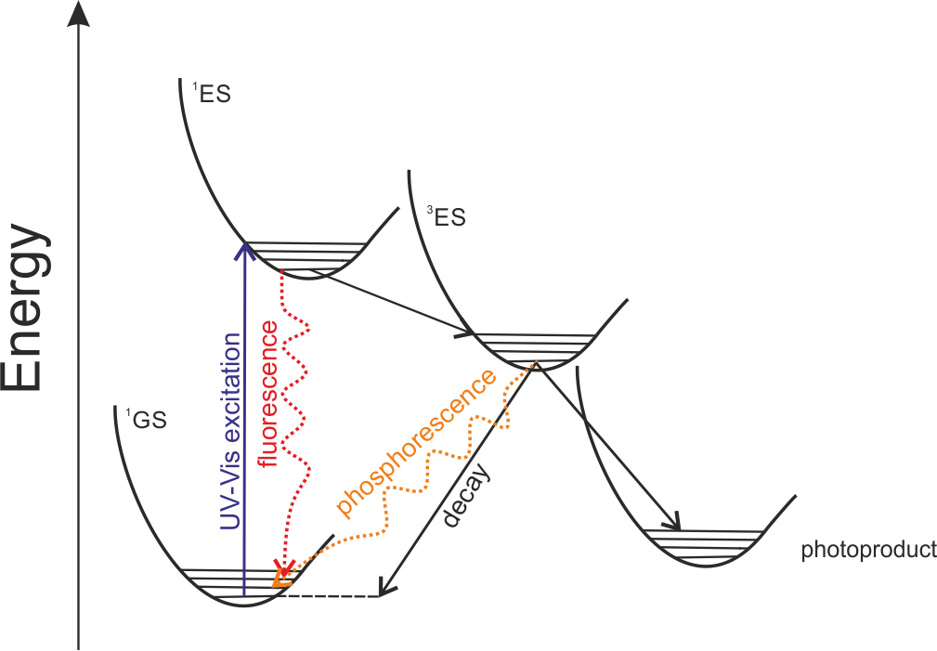
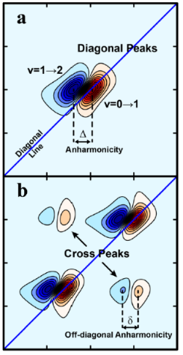
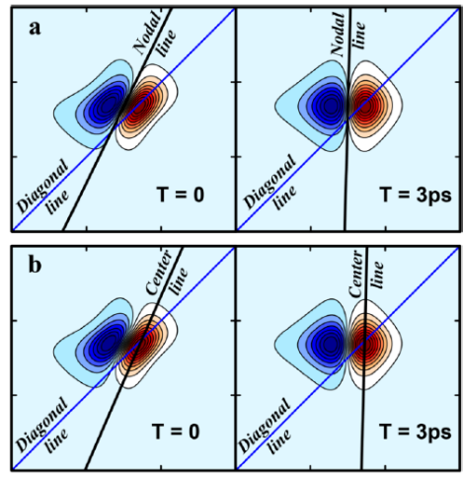
Excited state - general
Anharmonicity
and coupling
Solvation dynamics
Pump wavenumber
Probe wavenumber
Electronically excited state (EES)
Jablonski diagram
determined by nature and localization of the molecular orbital
Vibrational excited state (VES)
understanding of the ultrafast vibrational dynamics (vibrational energy transfer)
connected to processes such as photoexcitation and photoisomerisation

Slide 23
Relaxation processes in ReAz
¹MLCT
^{3#}MLCT, “t=0”
Instantaneous shift
• vibrational cooling: 2-4 ps
~6700
cm⁻¹
Cooling, reorientation of surface-bound D₂O : 7-25 ps
hν
400 nm
chromophore-peptide reorientation:
150-600 ps
³MLCT
Effect of relaxation-induced
change in ³MLCT wavefunction
GS

Slide 24
TR-spectroscopy – instrumentation of 2DIR

Slide 25
TR-spectroscopy – instrumentation of 2DIR

