Slide 1
Communication in the microbial world
How and why do microorganism talk to each other and how we can listen to them?

Slide 2
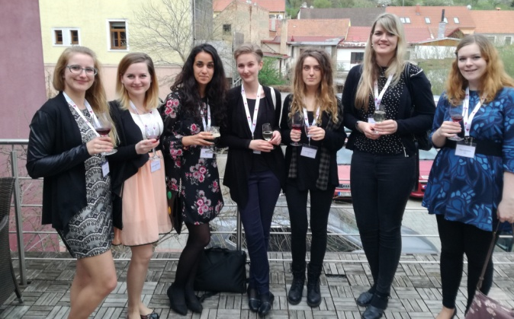
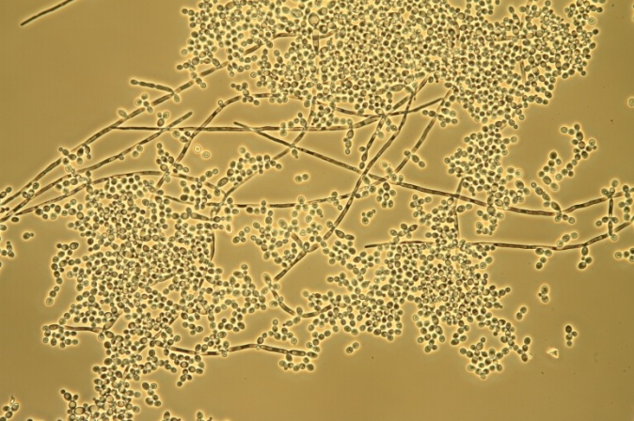
How do microorganisms talk to each other?
people
microorganisms
words
  say
  hear
  reply
signal molecules
  produce
  detect
  react
„We have
a good time at the conference.“

Slide 3
Why do microorganisms talk to each other?
= ADVANTAGE
different behaviour
  production of virulence factors
    hydrolytic enzymes, toxins, biosurfactants, siderophores, pigments, adhesins, exopolysaccharides
  biofilm development
  change of morphology
  sporulation
  production of antibiotics
  plasmid transfer
PRODUCTION + DETECTION + RESPONSE = QUORUM SENSING

Slide 4
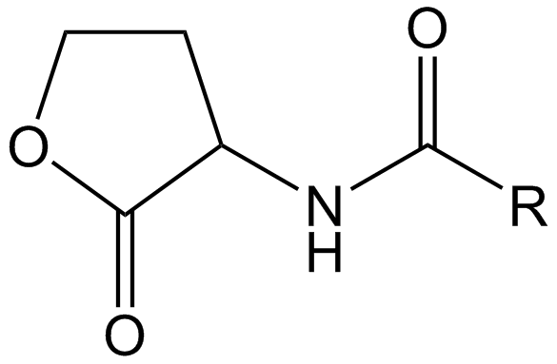
How and why do Pseudomonas aeruginosa talk?
main signal molecules:
  N-(3-oxo-dodecanoyl-homoserine lactone (3-oxo-C12-AHL)
  N-butanoyl-homoserine lactone (C4-AHL)
  2-heptyl-3-hydroxy-4-chinolon (PQS)
  2-(2-hydroxyphenyl)-thiazole-4-carbaldehyde (IQS)
activation of gene expression and subsequent production of virulence factors:
  LasB elastase, alkaline protease,
  exotoxin A, exopolysaccharides
  rhamnolipids
  pyocyanin, lectine
  biofilm
N-acyl-homoserine lactone

Slide 5
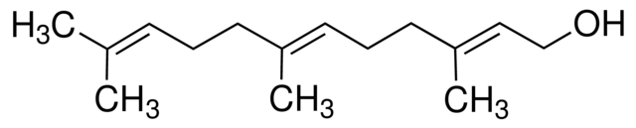
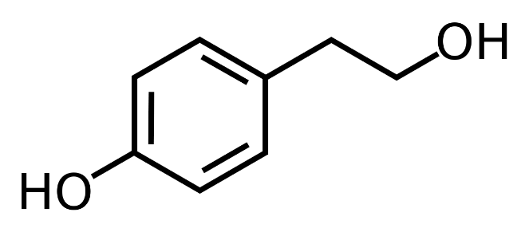
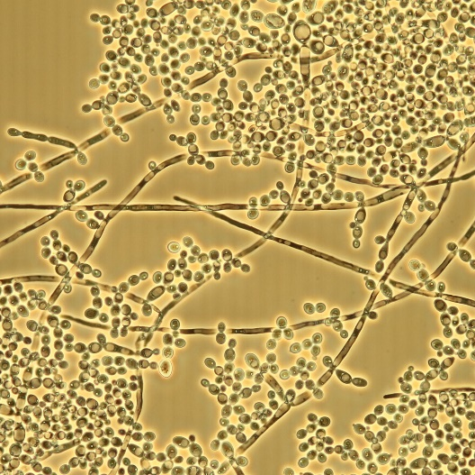
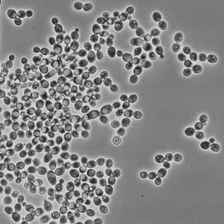
How and why do Candida albicans talk?
main signal molecules:
  FARNESOL
  TYROSOL
    produce a wide range of virulence factors,
  including hypha and biofilm formation

Slide 6

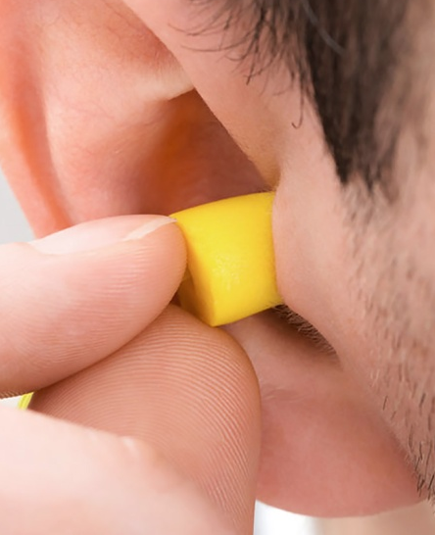
Anti-QS strategy
„don't talk and don't listen“
sender
receiver
receiver
sender
Communication noise

Slide 7

How can we listen to microorganisms?
detection of signal molecules
  use of biosensors
  use of UHPLC
IUPAC definition for biosensors¹: „devices using specific biochemical reactions mediated by isolated enzymes, immunosystems, tissues, organelles or whole cells to detect chemical compounds usually by electrical, thermal or optical signals.“

Slide 8
Biosensors
Chromobacterium violaceum
N-hexanoyl-homoserine lactone (C6-AHL)
violacein
C. violaceum CECT 494
  → produce C6-AHL
for simple screening of ANTI-QS activity
  → inhibition of violacein biosynthesis
C. violaceum CV026
transposon inserted
  into the AHL-synthase gene
  into the violacein repressor locus
→ does not produce C6-AHL
for detection of short chain AHL (C4-C8)
→ induction of violacein biosynthesis
Inhibition of violacein production in C. violaceum CECT 494 by orange and rosemary honeys at different concentrations (Truchado et all., 2009)²
TLC analysis on C18-reverse phase TLC plates chromatographed in methanol/water (60:40, v/v) and visualized with C. violaceum CV026 (Chen et all., 2013)³

Slide 9
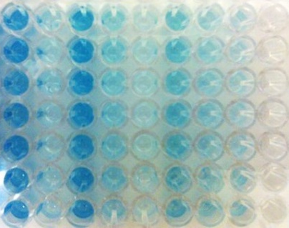
Biosensors
Agrobacterium tumefaciens NTL4(pZLR4)
= Rhizobium radiobacter
N-(3-oxo-octanoyl)-homoserine lacton (3-oxo-C8-AHL)
transfer of Ti plasmid
biosensor
  → does not produce 3-oxo-C8-AHL
  contains instead of Ti plasmid an inserted plasmid (pZLR4)
  for detection of broad spectrum of AHL (C4-C12)
    → expression of beta-galactosidase

Slide 10
Biosensors
Agrobacterium tumefaciens NTL4(pZLR4)
The mechanism of of X-Gal conversion
ADVANTAGES:
• high sensitivity to a wide range of AHL
• small sample volumes
•large number of samples
lysis buffer addition:
MgCl₂∙6 H₂O 4.4 g/l
CTAB 0.2 g/l
NaN₃ 0.8 g/l

Slide 11
Biosensors
• use bioluminiscence
• use GFP
E. coli (pSB536)
E. coli (pSB401)
E. coli (pSB1142)
Vibrio fischeri
Structure of green fluorescent protein (GFP) (Tsien 1998)⁴
Why biosensors?
• detection of low concentrations of AHL in samples
• in complex matrix
• sample preparation is not required

Slide 12
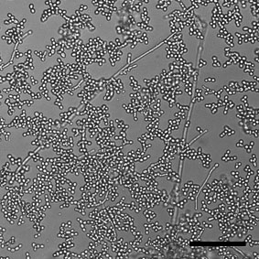
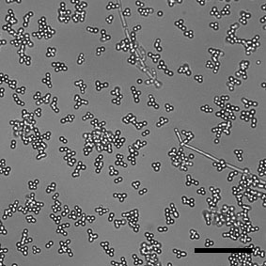
How can we listen to C. albicans?
UHPLC-MS/MS
the mechanism by which farnesol is getting out from cells and receptors were not described yet
use of natural substances for hyphae and biofilm inhibition
  possible mechanism of action?
    → upregulation of the gene encoding phosphatase - a key enzyme for farnesol biosynthesis
    ↑ farnesol, tyrosol?
Change in C. albicans ATCC 2091 morphology, control on the left and exposure to quercetin
(50 mg/l) on the right, scale bar = 100 μm.

Slide 13
UHPLC-MS/MS
(triple quadrupole)
The Department of Chemistry of Natural Compounds
method was optimized accroding to study
  Greguš, P., Vlčková, H., Buchta, V., Kestřanek, J., Křivčíková, L., Nováková, L. (2010) Ultra high performance liquid chromatography tandem mass spectrometry analysis of quorum-sensing molecules of Candida albicans. Journal of pharmaceutical and biomedical analysis 53(3), 674-681.
  → simultaneous quantitative determination of farnesol and tyrosol
Specifications:
  sample preparation: deproteinization: acetonitrile, filtration: 0.2 μm PTFE filter
  UHPLC: BEH C18 analytical column, mobile phase: acetonitrile and 0.075% formic acid (75:25) using isocratic elution
  MS/MS: triple quadrupole tandem mass spectrometer, quantitation in ESI positive ion mode using SRM (selected reaction monitoring)

Slide 14
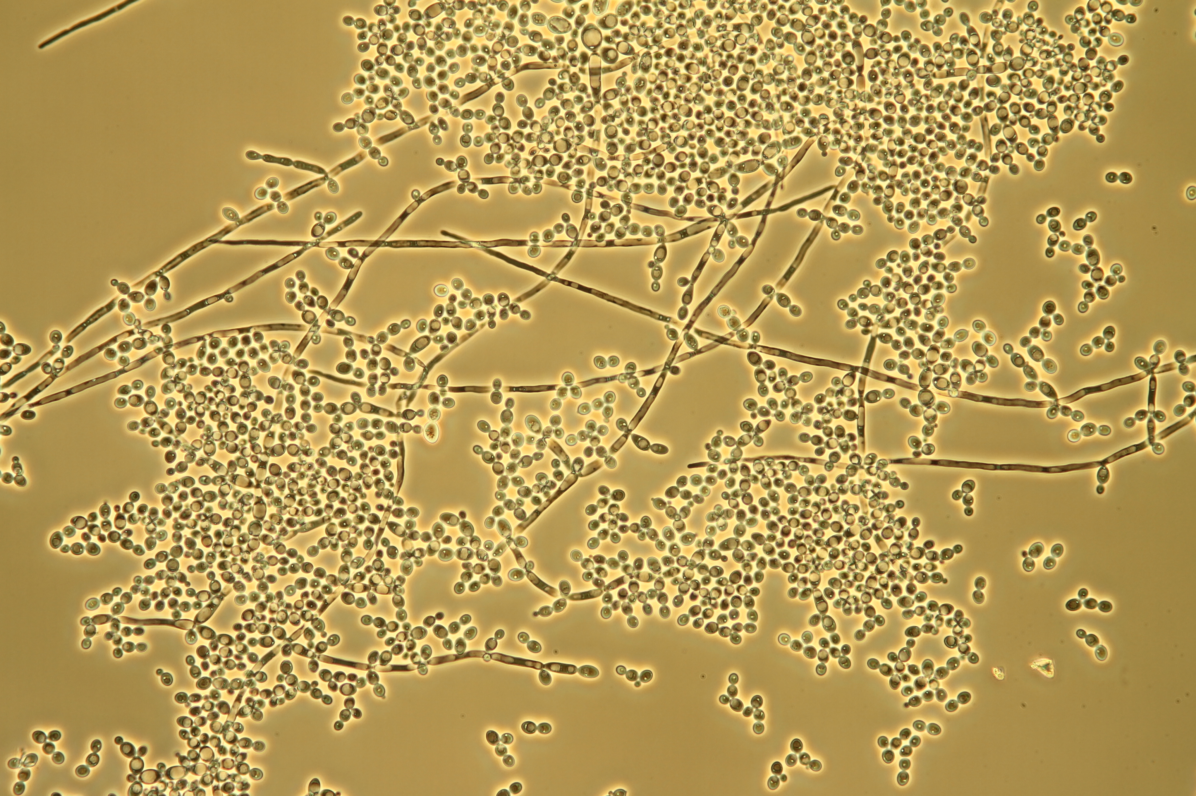
Summary
•stop microorganisms from communicating with each other
•monitoring the proces of communication by biosensors and UHPLC

Slide 15
Do you already know how bacteria talk and how can we listen to them?
Do you have questions?

Slide 16
Reference
1) Nayak, M., Kotian, A., Marathe, S., Chakravortty, D. (2009) Detection of microorganisms using biosensors—A smarter way towards detection techniques. Biosensors and Bioelectronics 25(4), 661-667.
2) Truchado, P., López-Gálvez, F., Gil, M.I., Tomás- Barberán, F.A., Allende, A. (2009) Quorum sensing inhibitory and antimicrobial activities of honeys and the relationship with individual phenolics. Food Chemistry 115(4), 1337-1344.
3) Chen, J., Koh, C.-L., Sam, C.-K., Yin, W.-F., Chan, K.-G. (2013) Short chain N-acyl homoserine lactone production by soil isolate Burkholderia sp. strain A9. Sensors 13(10), 13217-13227

