Slide 1
Endophytes and plants
A hidden love affair

Slide 2
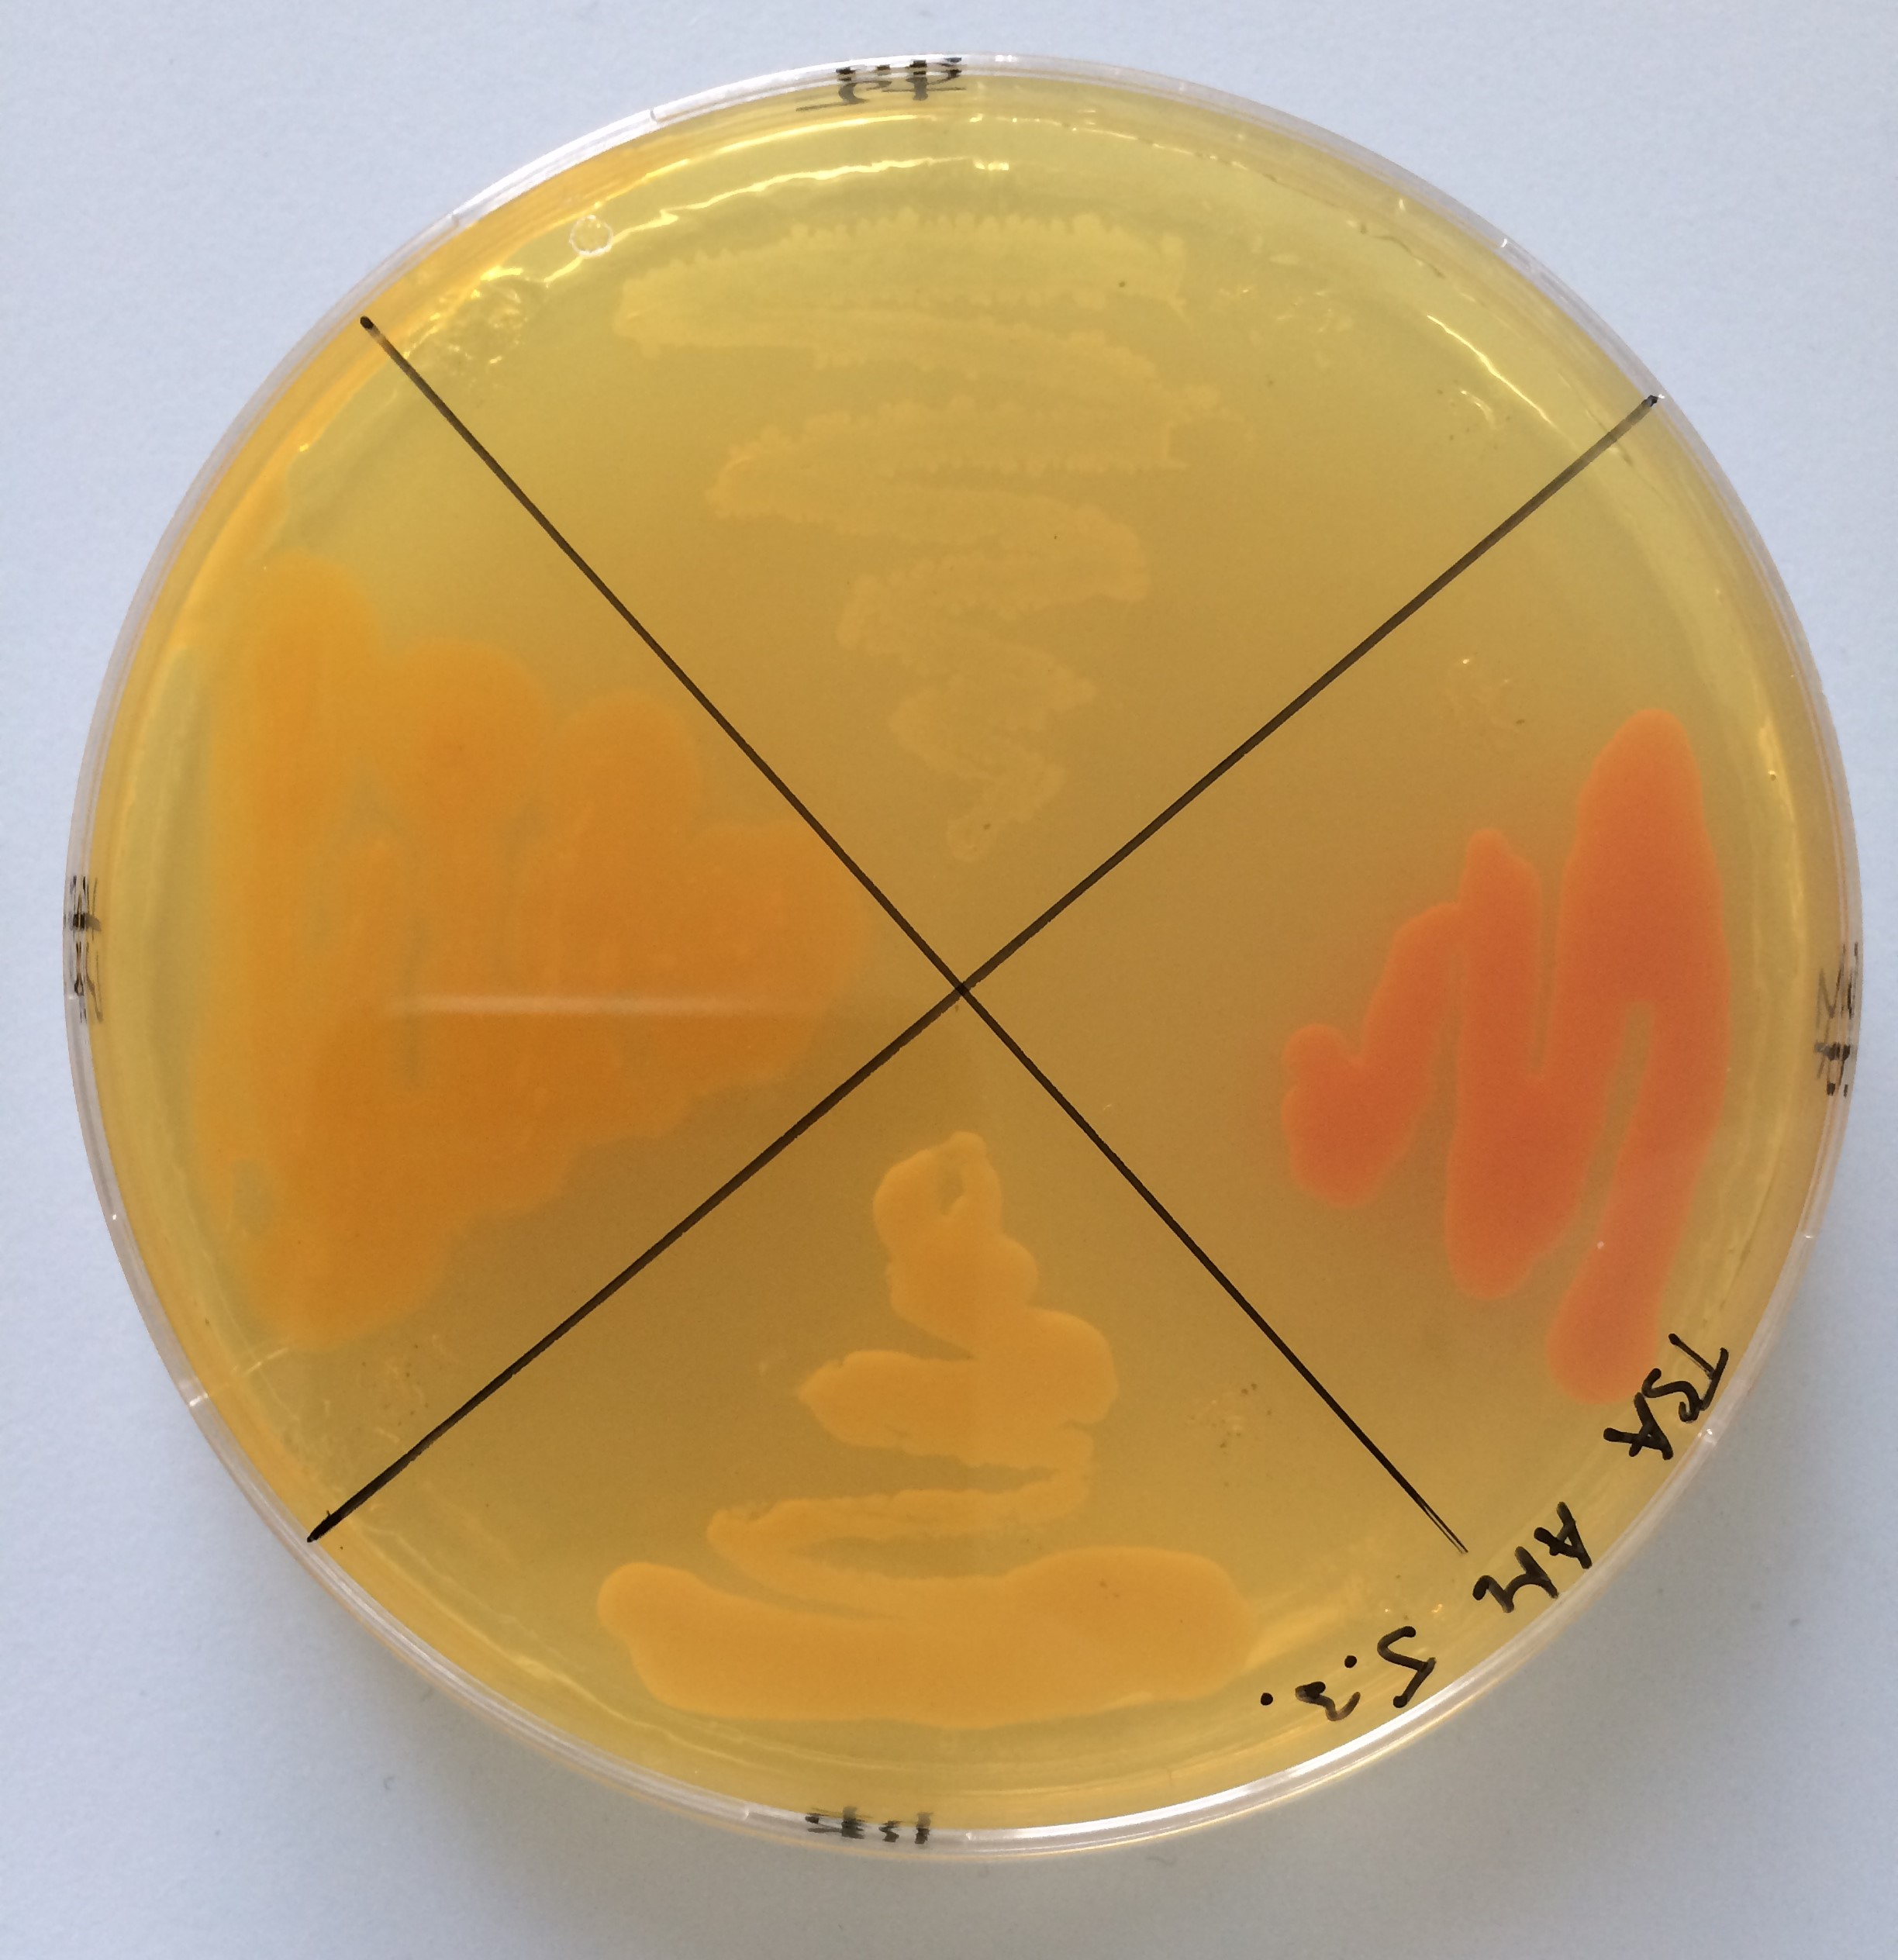
Endophytes
Endophytes = microorganisms living inside the plant tissue
Relationships:
Neutral
Mutualistic
Commensal

Slide 3
Colonization through damaged areas of the epidermis
B. + C. Colonization through epidermal cracks
D. Colonization facilitated by fungal root penetration

Slide 4
Plant growth promoting properties
Enhancing the availability and assimilation of nutrients
Synthesis of specific compounds required by plants
Plant protection against phytopathogens

Slide 5
Biofertilization
Biofertilization = increasing the availability of nutrients that support plant growth
Biological fixation of nitrogen, dissolution of bound phosphorus

Slide 6
Biological fixation of nitrogen
Diazotrophy = conversion of atmospheric nitrogen to ammonia using the enzyme nitrogenase
Diazotrophic endophytic bacteria → rise in the total nitrogen content of the plant

Slide 7
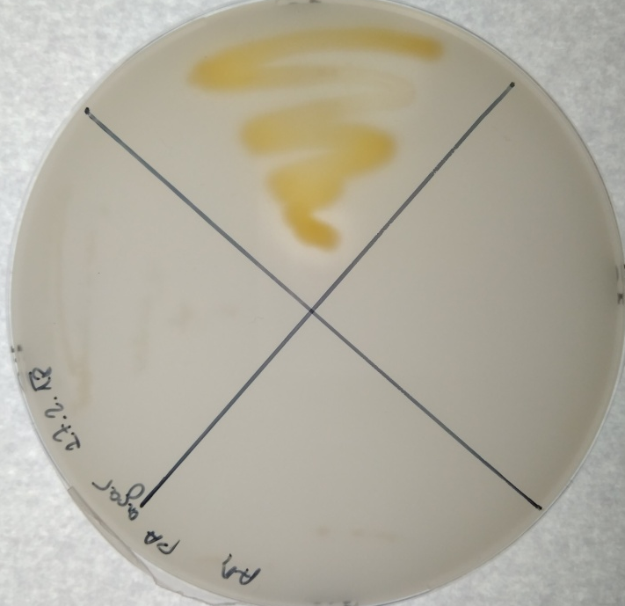
Phosphate solubilization
Phosphorus in soil in insoluble forms:
inorganic minerals - apatite
organic forms - inositol phosphate, phosphomonoes and phosphotriesters

Slide 8
Phosphate solubilization
Organic acid-producing bacteria (gluconic, lactic, oxalic, citric):
chelation of phosphorus-bound metal cations
soil pH decrease → release of phosphate ions

Slide 9
Phytostimulation
Phytostimulation = growth support by phytohormones production:
auxins
cytokinins
Giberellins
abscisic acid

Slide 10
Biocontrol
Biocontrol = support for growth through protection against phytopathogens:
Production of antimicrobial substances
Production of lytic enzymes
Competition for nutrients

Slide 11
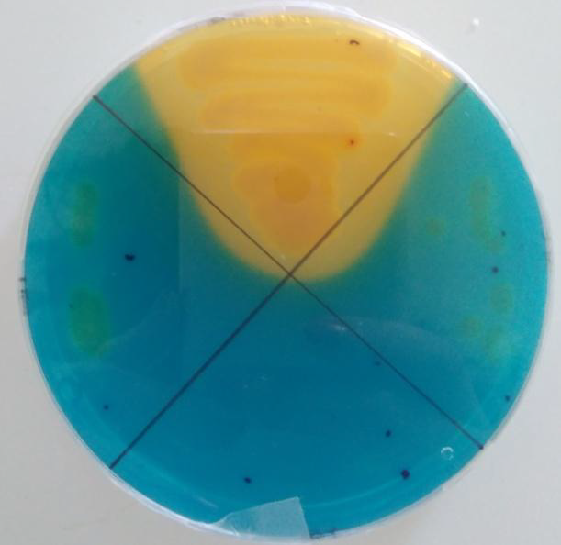
Bacterial siderophores
Siderophores = low molecular weight molecules capable of binding Fe³⁺
Competition for iron with phytopatogens
Possible supply of iron for plants

Slide 12
What do we do?
Isolation of endophytes from grapevine (Vitis vinifera)
Test their plant growth promoting properties
Determine differences between bio/conventional vineyards
Determine differences between seasons

