Slide 1
‘Natural’ food additives – Are they worth it?
Shedding some light on the controversy of conventional food additives or creating more entropy?
Ing. Markéta Adamcová
Department of Food Preservation
Faculty of Food and Biochemical Technology
University of Chemistry and Technology Prague

Slide 2
definition of food additives
„Food additive is any substance not normally consumed as a food itself and not normally used as a characteristic ingredient of a food, whether or not it has nutritive value, the intentional addition of which to a food for a technological purpose in the manufacture, processing, preparation, treatment, packaging, transport or storage of such food results, or may reasonably expected to result, in it or its by-products becoming directly or indirectly a component such food.“ (Regulation (EC) No 1333/2008)

Slide 3
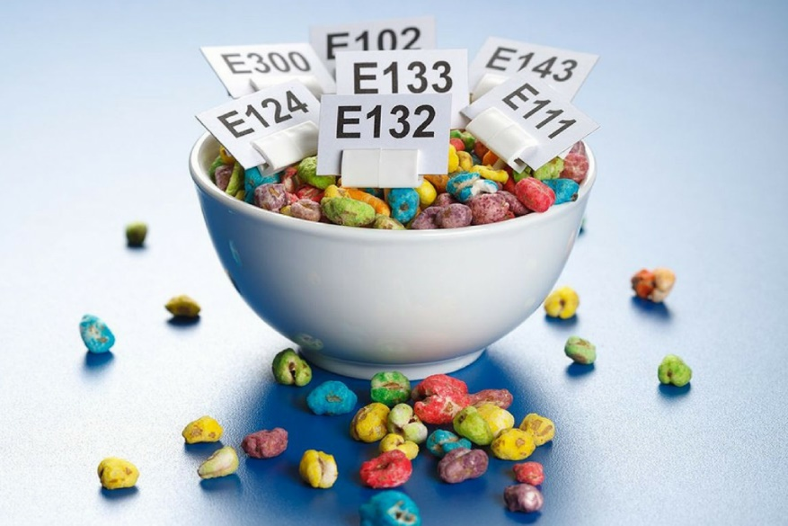
division of the food additives
origin of the additives:
synthetic
natural identical
natural
groups of food additives:
preservatives
antioxidants
colours
sweeteners
acids and acidity regulators
and other compounds according to Regulation (EC) No 1333/2008

Slide 4
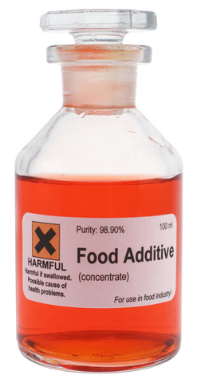
controversial additives
preservatives:
benzoates( E 210 – E 213), sorbates (E 200 – E203), propionates (E280 – E283)
parabens (E214 – E 219)
SO₂ (E 220)
nitrites (E250)
antioxidants
butylated hydroxyanisole (E 320)
butylated hydroxytoluene (E321)
colours
indigocarmine (E 132)
tartrazine (E102)
ponceau 4R (E 124)
sweeteners
acetsulfame K
aspartame

Slide 5
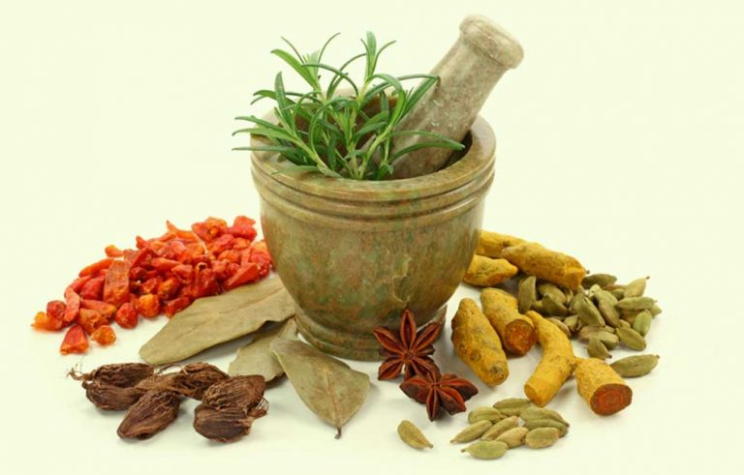
natural food additives as an alternative
the lack of the official definition of natural food additives
active compounds from plants
herbs, spices, fruits and vegetables
antimicrobial compounds produced by microorganisms
organic acids (lactic, propionic etc.)
bacteriocins
specific active compounds from animal products
lactoperoxidase system of milk
lysozyme
ovotransferrin and lactoferrin
cochineal, carminic acid and carmines (E120)

Slide 6
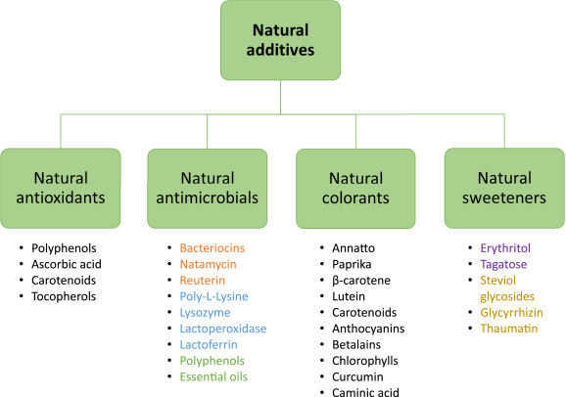
division of natural food additives
Carocho, M.; Morales, P.; Ferreira, I. (2015): Natural food additives: Quo vadis? Trends in Food Science & Technology, 45, 284 – 295.

Slide 7
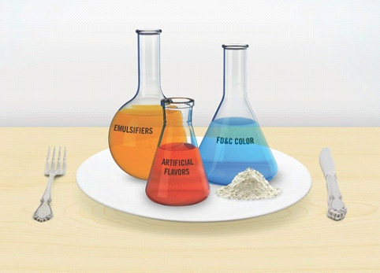
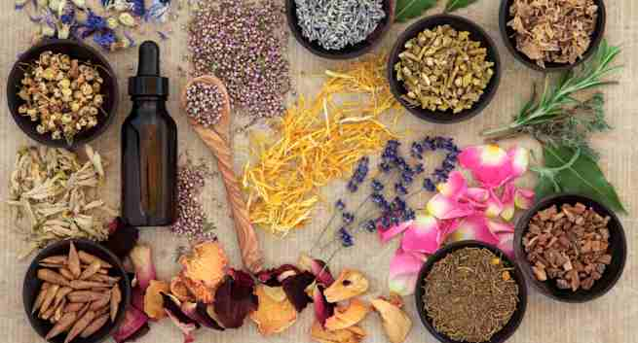
controversial versus natural additives what to consider when dealing with this
costs
stability
effectiveness
acceptability
impact on the quality of the final product

Slide 8
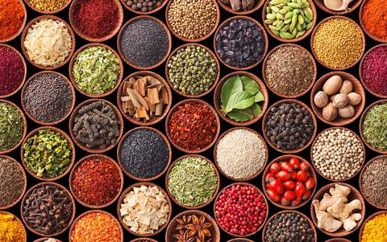
way of the addition of natural food additives
as an ingredient of the food
traditional
whole parts of plants or the plant waste
an ingredient does not need an E number
the impact of the growing conditions
microbial contamination – immediate usage or conservation
drying, high pressure processing, SO₂, sorbates, benzoates
overharvesting?

Slide 9
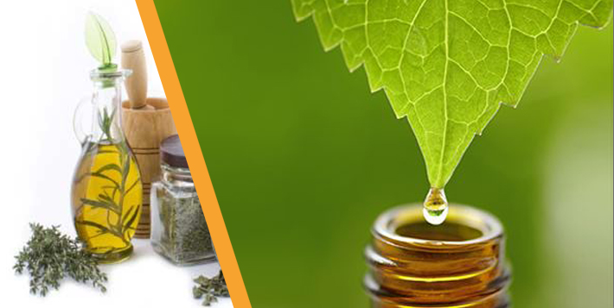
way of the addition of natural food additives
as an extract
standardized concentration of active compounds - better for food processing
necessity of legislative approval to being used – E number
limited ways of extraction – water, oil, ethanol or modern (and expensive) approaches
lower stability of natural additives in comparison with their synthetic cousins
microbial contamination – immediate usage or conservation
pasteurization, drying, additives (ascorbic acid, sorbates, benzoates)

Slide 10
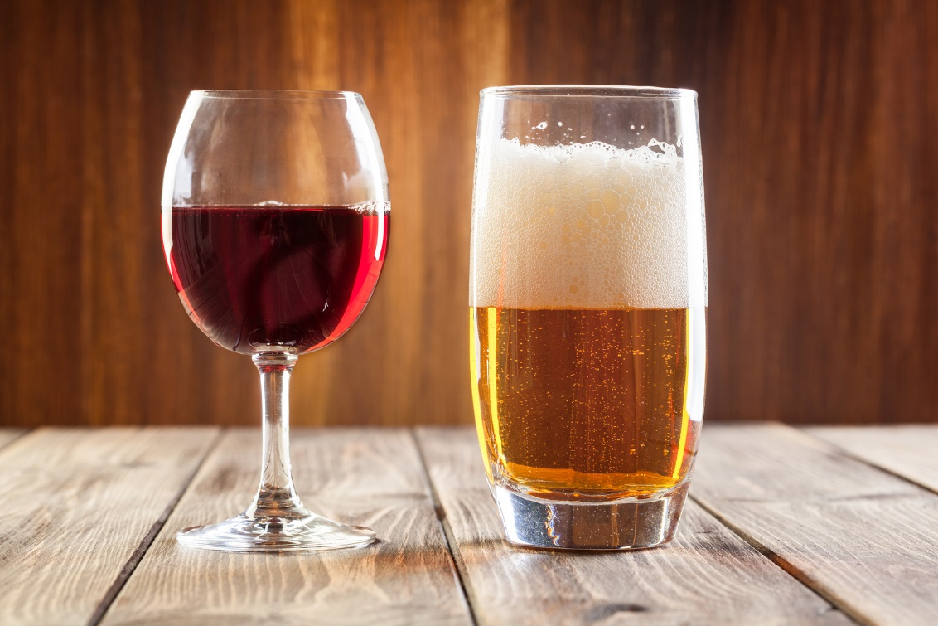
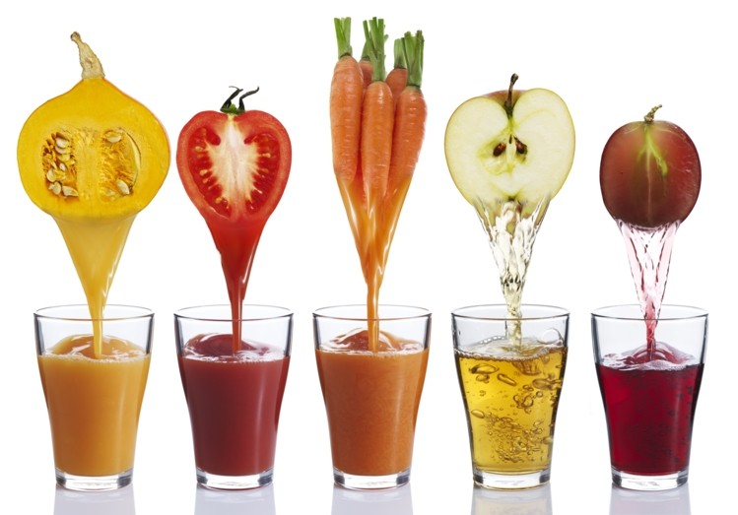
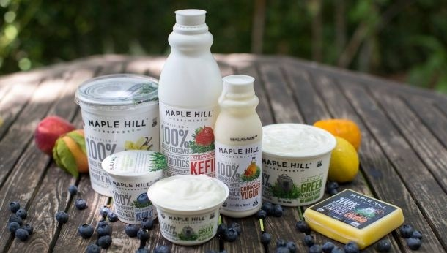

Slide 11
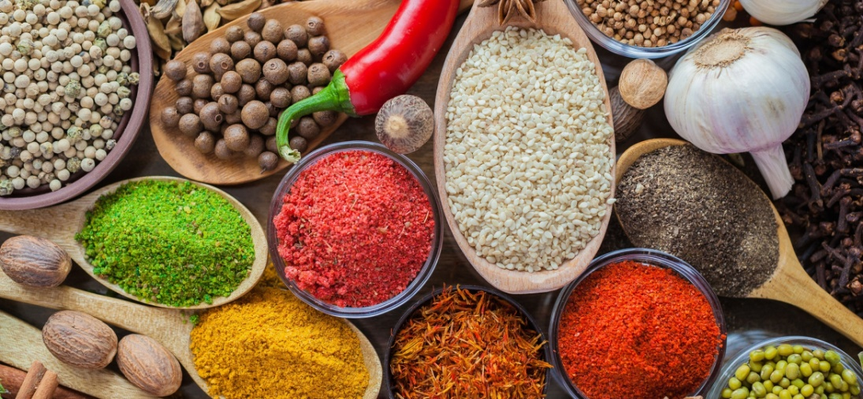
conclusion remarks
preference of natural additives over synthetic ones – cool – but where is their clear definition?
iincreasing demand = increasing supply – very good - but limitations still linger
new sources of natural additives –new E numbers - is it bearable for consumers?
education, education, education

Slide 12
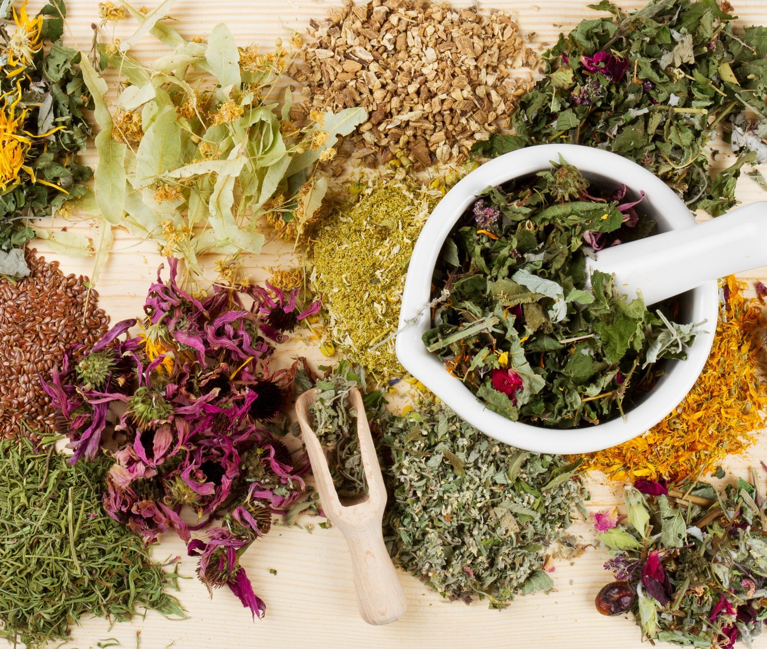
Thank you for your attention.

Slide 13
references
Adams, M. R.; Moss, M. O. (2008): Food mikrobiology. RSC Publishing, Cambridge, 3rd eddition, 463 p. ISBN 978-0-85404-284-5
Baines, D.; Seal, R. (2012): Natural food additives, ingredients and flavourings. Woodhead Publishing Limited, Cambridge, 1st eddition. 459 p. ISBN 978-1-84569-811-9
Carocho, M.; Morales, P.; Ferreira, I. C. F. R. (2015): Natural Food Additives: Quo vadis? Trends in Food Science & Technology 45, 284 – 295.
Carocho, M., Barreiro, M. F., Morales, P., & Ferreira, I. C. F. R. (2014). Adding molecules to Food, pros and cons: a review of synthetic and natural food additives. Comprehensive Reviews in Food Science and Food Safety, 13, 377e399
EFSA Regulation. European food Safety Authority, Regulation No. 1333/2008. http:// eur-lex.europa.eu/legal-content/EN/TXT/HTML/?uri¼CELEX

